Slide 1
Additions and Alterations
Nonresidential Mechanical
Bruce Cheney
  Anchors Aweigh Energy
David Wylie
  ASWB Engineering
November 15, 2018

Slide 2

Who are we talking with?
What’s your role?
Why are you interested in energy code?
Why are you in this session?

Slide 3

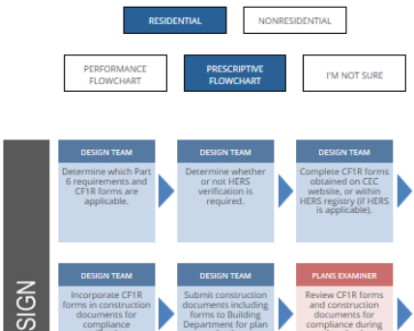
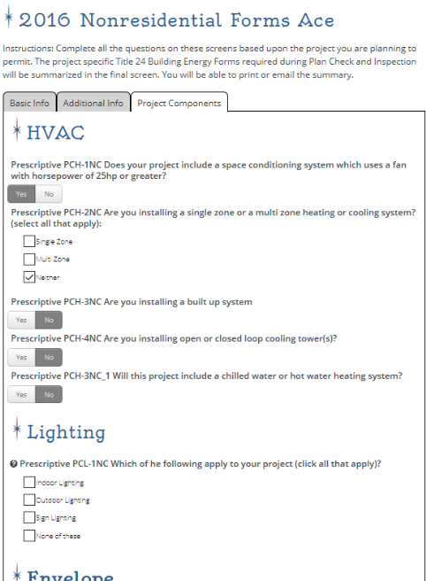
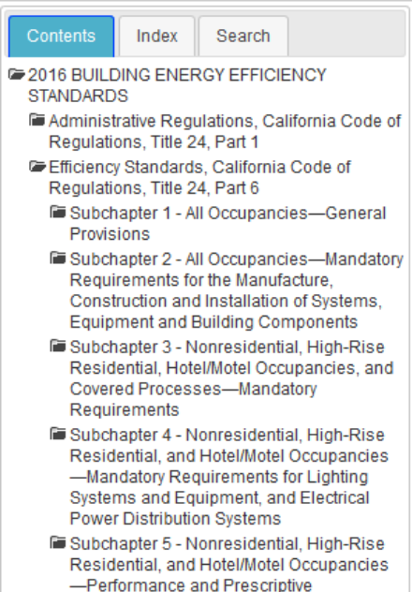
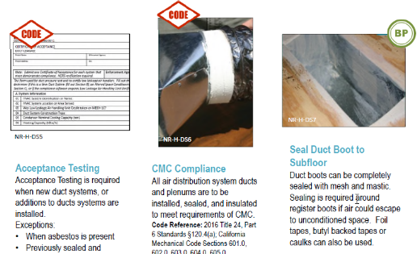
Earlier we explored using Energy Code Ace for
New Construction
3 – 4
Navigator Ace
Forms Ace
Summary info on roles, responsibilities and documentation for all project phases with links to the details
Project-specific guidance on the forms you need and links to get them — along with a summary of what you specified for the project that’s savable for future reference
Reference Ace
Actual code language with hyperlinks to related sections and tables, key word search, pop-up definitions and linkage between Title 24, Part 6 and Title 20
Installation Ace
Clear examples of what does and does not meet Title 24, Part 6
installation requirements

Slide 4







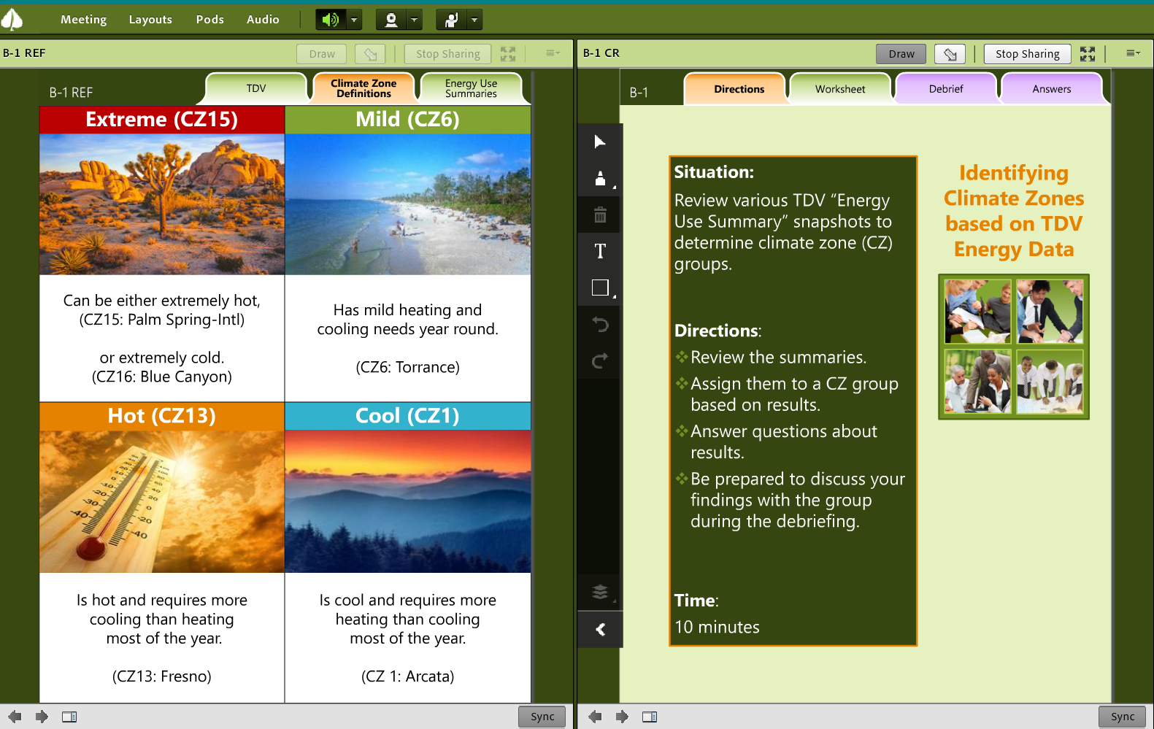

Earlier we explored using Energy Code Ace for
New Construction (cont.)
8 – 9
Live Training
On-demand Training
In-person and online options let you interact with experts, work with your peers and apply what you’ve learned
Self-study options let you get the basics at your own pace — when and where you choose
Today’s hot topics with expert hosts
Live (interactive webinars and YouTube broadcasts)
On-demand (recordings of live sessions and handouts)

Slide 5


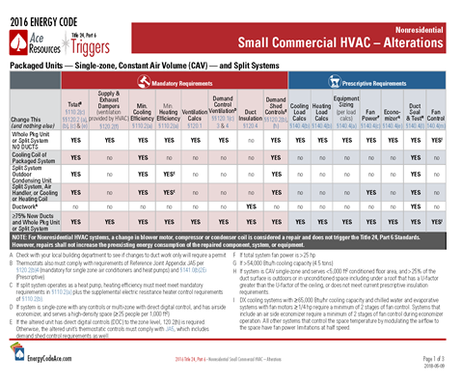
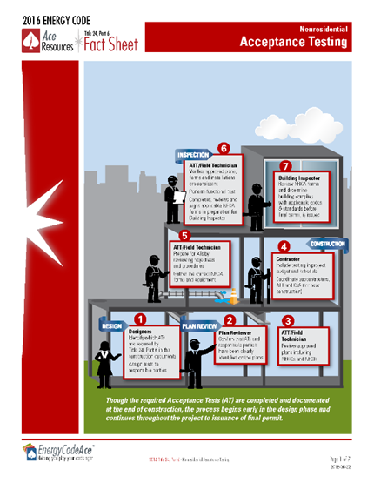
Earlier we explored using Energy Code Ace for
New Construction (cont.)
16 – 19
Application Guides
Trigger Sheets
In-depth looks at technologies, systems and compliance strategies with guidance on designing to code
Fact Sheets
Tables of “if you change this, these parts of the code is triggered with links to relevant code sections
Summary of essential facts about compliances with links to additional sources of information

Slide 6
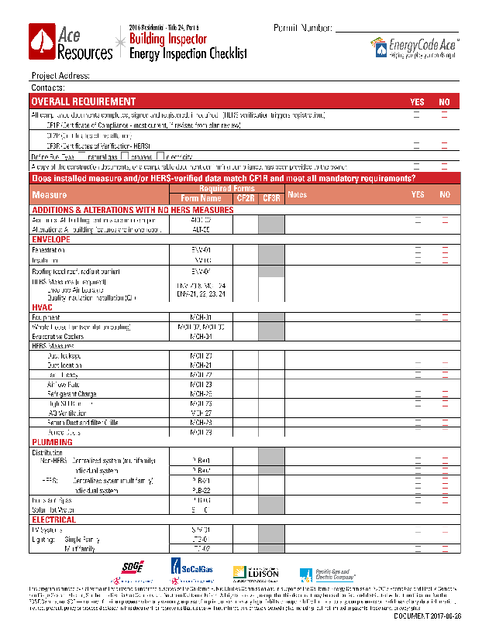
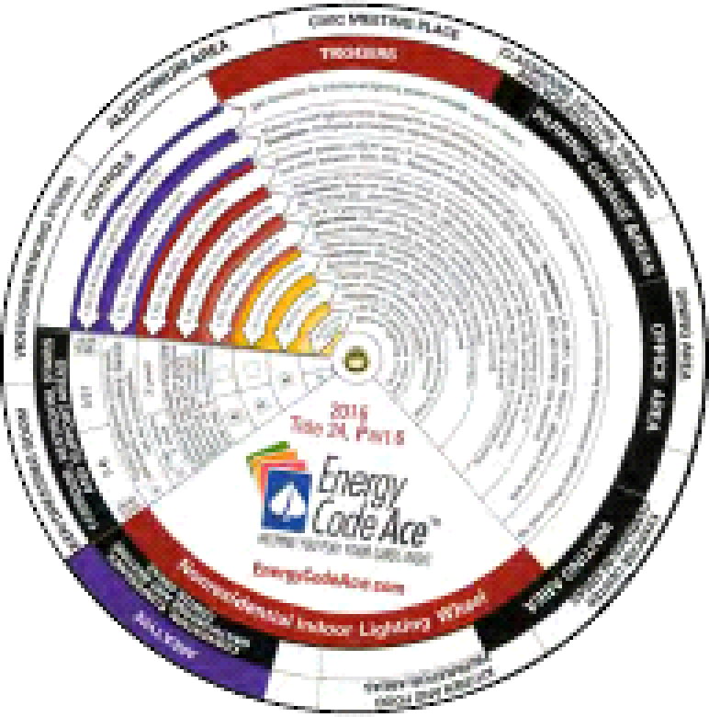
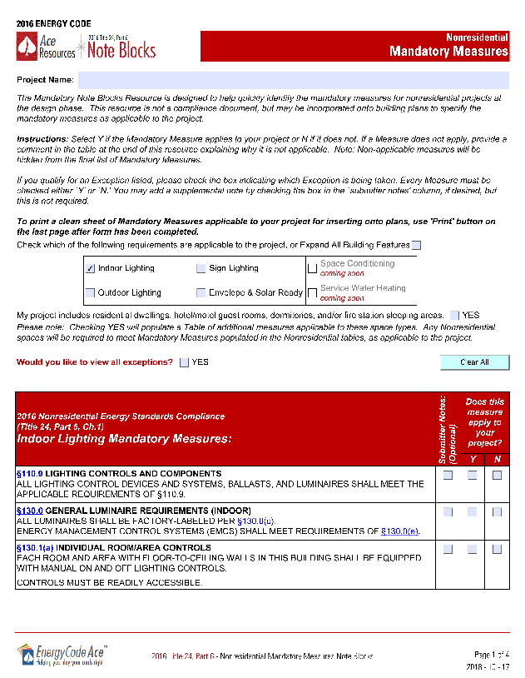
Earlier we explored using Energy Code Ace for
New Construction (cont.)
16 – 19
Checklists
Lighting Wheel
What Plans Examiners and Building Inspectors look for relative to
Title 24, Part 6 compliance
Note Blocks
Fun and easy hands-on guide for those who design, specify, install or inspect nonresidential lighting installations
Dynamic resource that summarizes what’s mandatory for a given project; printable to include with project docs
Nonres only, at this time

Slide 7
So many options… where do you start?
22
SHOW ALL AT ONCE
When you want…
Where do you look?
A comprehensive look at an area to understand alternatives
Application Guide
Traditional class, v-class, vorkshop, online self-study (OLSS)
A deep dive on a specific area and how it applies to you
Application Guide
Traditional class, v-class, vorkshop, OLSS, Decoding Talk, Code & Coffee
The big picture of a process or measure
Fact Sheet
Application Guide
Tips for finding compliant product
Application Guide
Info on roles, responsibilities and documentation for all project phases
Navigator Ace
Application Guide
Fact Sheet
Guidance on complete, correct compliance documentation
Forms Ace
Fact Sheet
Application Guide

Slide 8
So many options… where do you start? (cont.)
22
SHOW ALL AT ONCE
When you want…
Where do you look?
A quick summary of relevant code requirements
Fact Sheet (New and Alterations)
Triggers Sheet (Alterations)
The details on the code or exact code verbiage
Reference Ace
Answer to “If I change this, what parts of the code do I need to be concerned with?”
Triggers Sheet
A summary of forms required for a project
Forms Ace
Fact Sheet or Triggers Sheet
A look at what enforcement agency personnel check for
Plans Examiner Checklist
Building Inspector Checklist
Installation Ace
Help ensuring your project addresses relevant mandatory measures
Note Blocks (Nonres only at this time)
Triggers Sheet

Slide 9
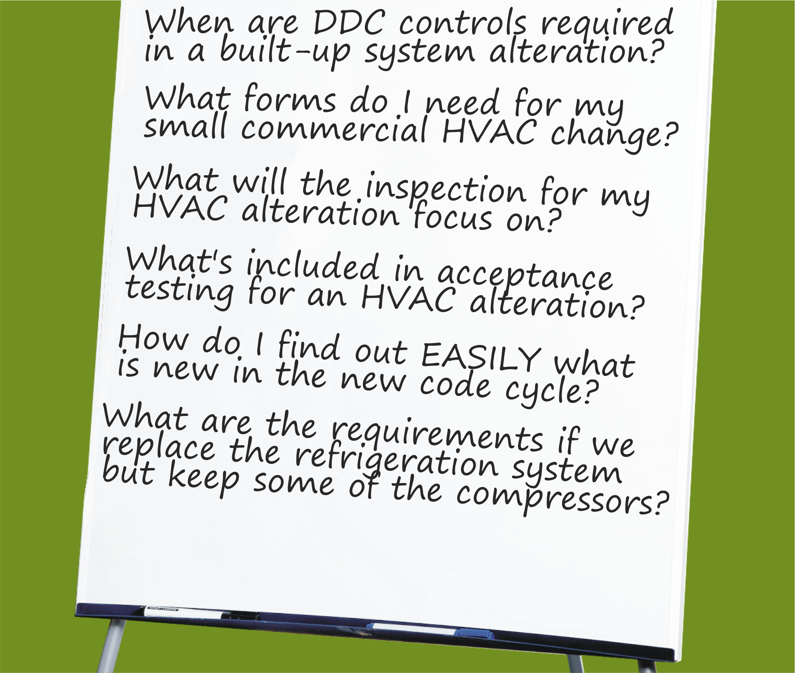

What Questions Do You Want Answered?
Track Specific

Slide 10
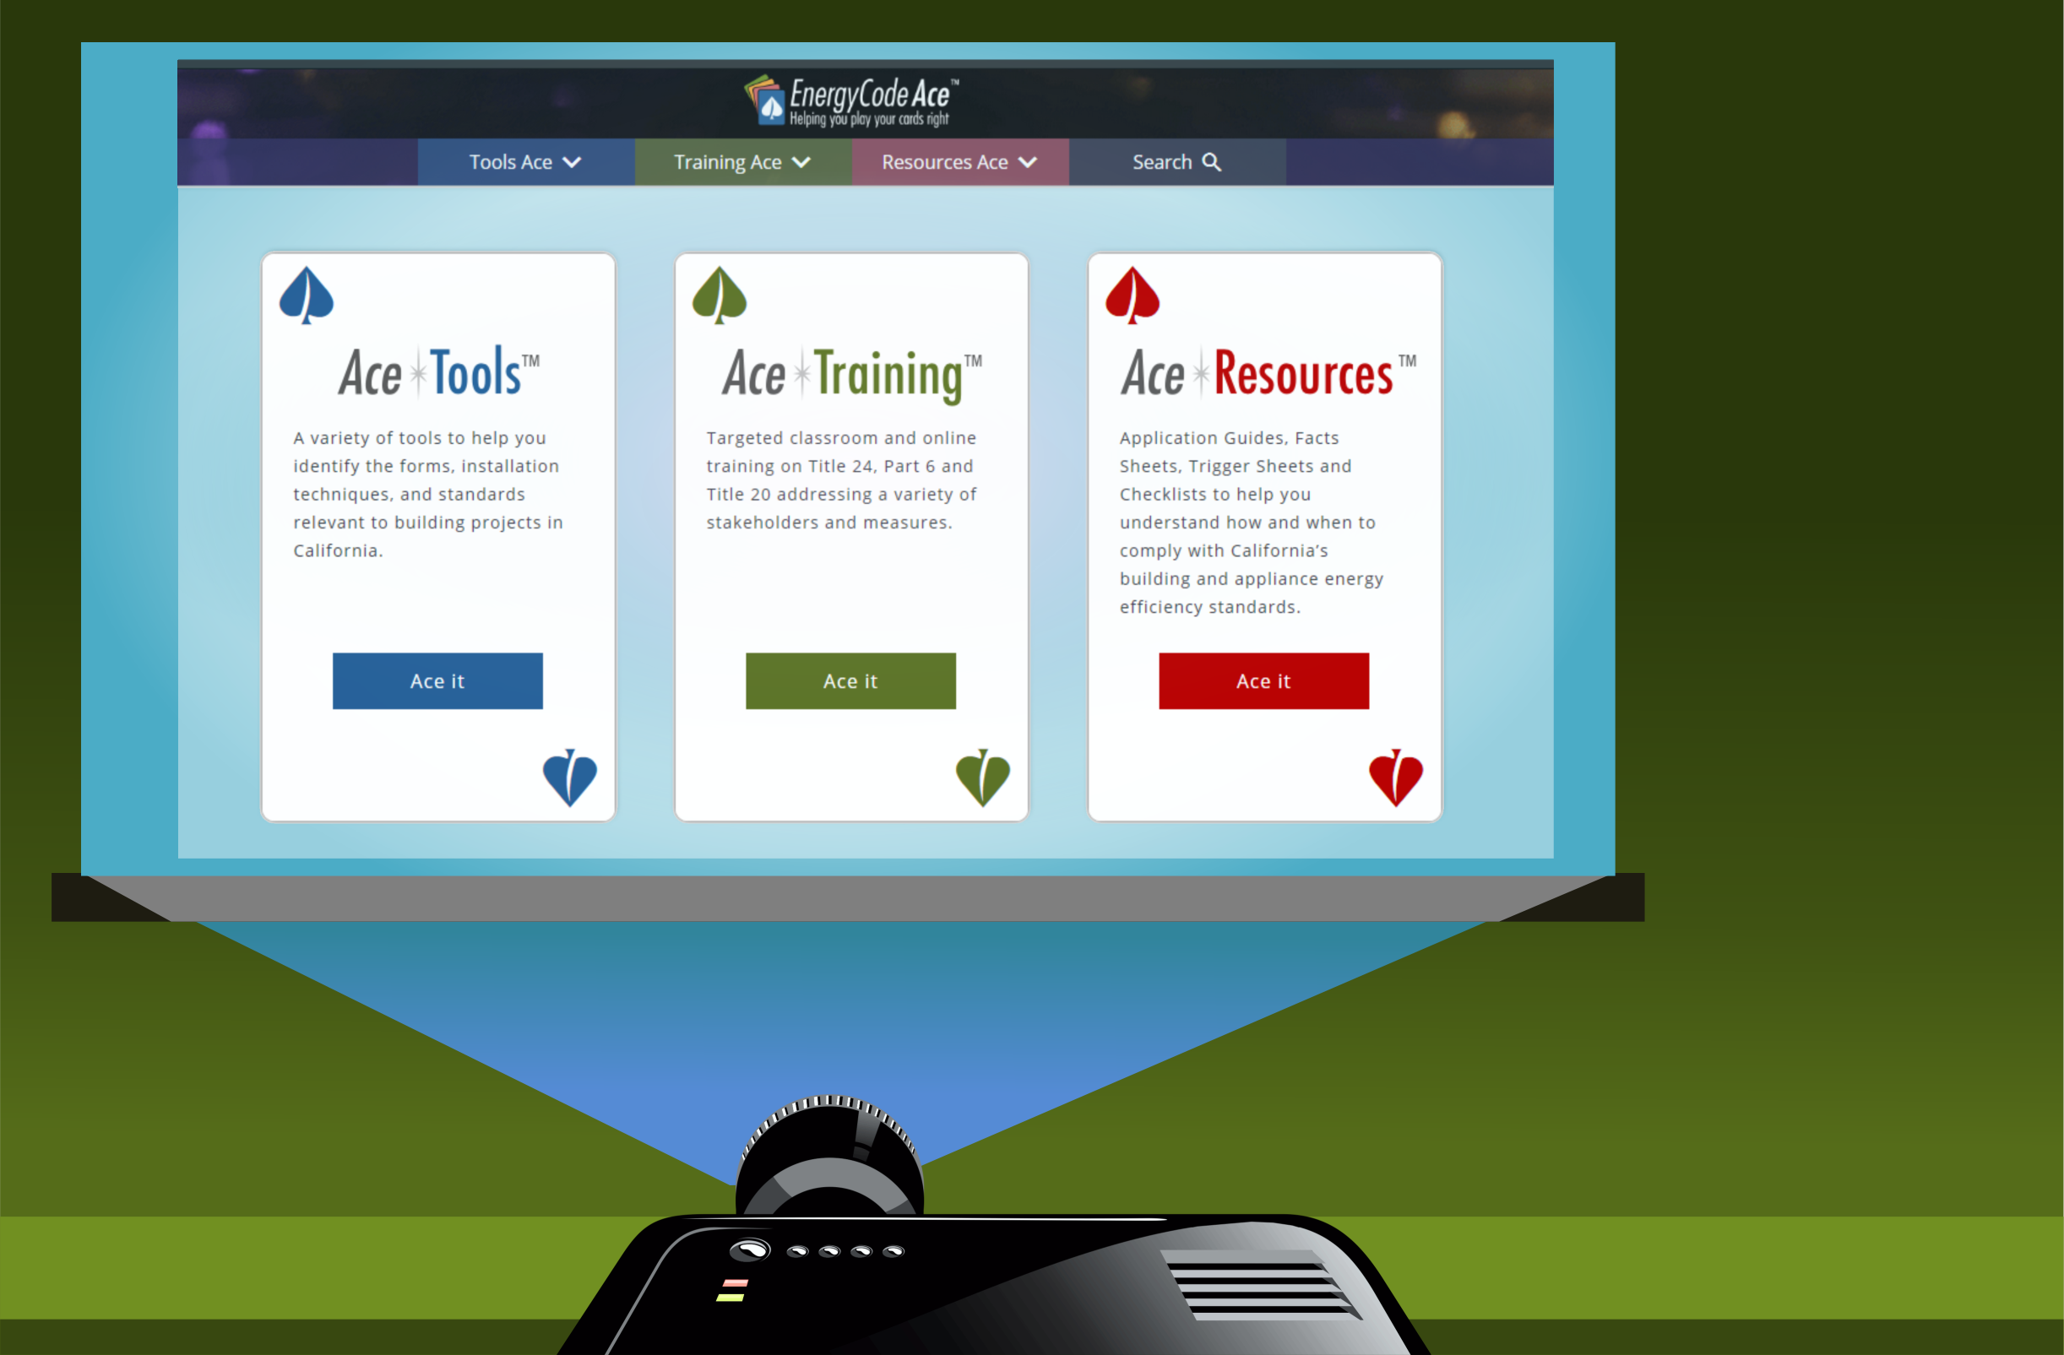

Let’s show you how to get some answers…

Slide 11

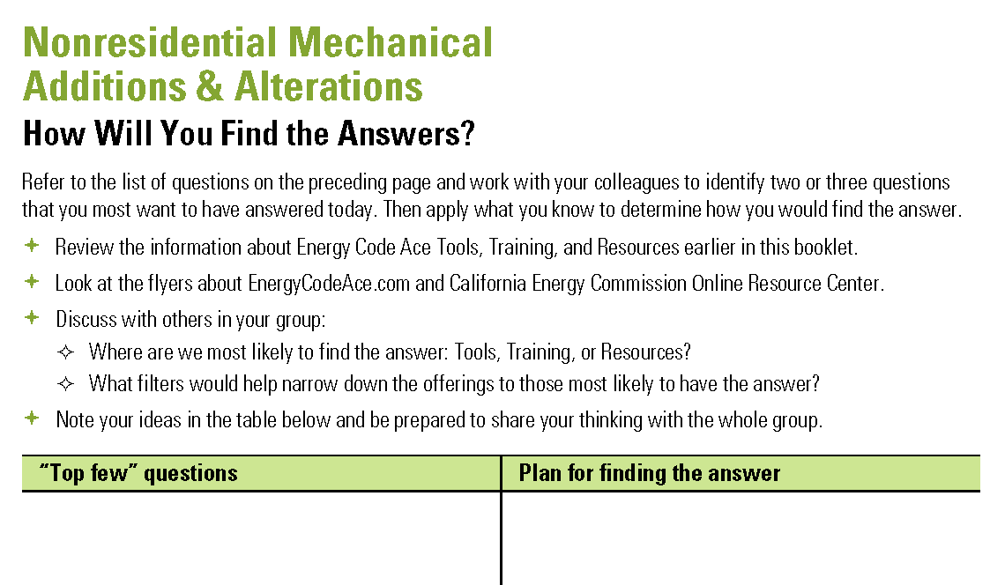
What Questions Do You Want Answered?
Track Specific
Work with your group to:
Identify “top few” questions you want answered
Plan where to find the answers
  Tools, Training, Resources?
  The filters to narrow your search?
Note your ideas in the Nonres Mechanical worksheet in your handout
Be prepared to share your group’s thinking with the whole group

Slide 12
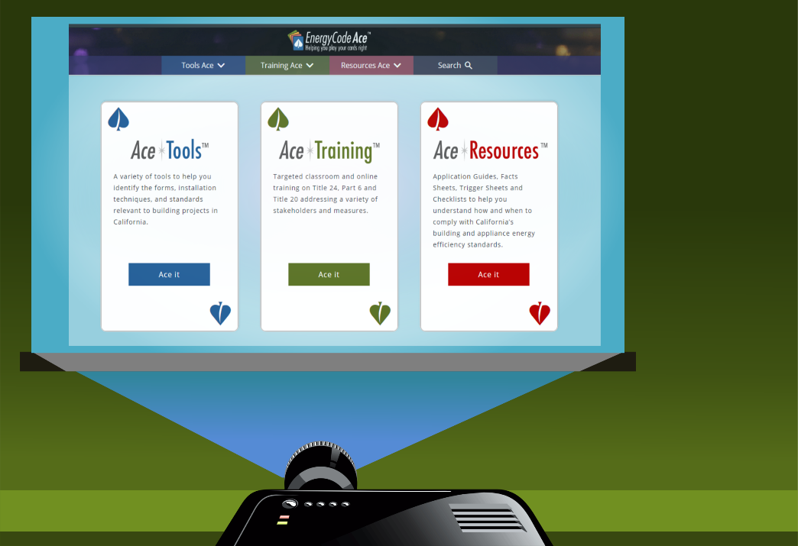

Let’s go fishing…
What is your group’s top question?
Where do you think we’ll find the answer?
  (Tell me how to get there, please.)

Slide 13

Conclusion
Anything before we go?
Questions?
Suggestions?
General comments?

Slide 14

Thank you for your participation!
Contact | Role | Email | Phone
Bruce Cheney | Instructor | Bruce@aae-hers.com | 858-254-1189
David Wylie | Instructor | dwylie@aswb-engineering.com | 714-731-8193
Jill Marver | PG&E | jkz1@pge.com | 925-415-6844
Ruby Yepez | SCE | Ruby.R.Yepez@sce.com | 626-302-0699
Jeremy Reefe | Sempra | JMReefe@semprautilities.com | 858-636-5533
Ray Mendoza | Sempra | RJMendo1@semprautilities.com | 562-803-7493
Notes:
***** Instructor Only *****
Before class: Please edit the title slide to include your name and organization.
***** End Instructor Only *****

Slide 15
So many options… where do you start?
22
NEXT
When you want…
Where do you look?
A comprehensive look at an area to understand alternatives
Application Guide
Traditional class, v-class, vorkshop, online self-study (OLSS)
A deep dive on a specific area and how it applies to you
Application Guide
Traditional class, v-class, vorkshop, OLSS, Decoding Talk, Code & Coffee
The big picture of a process or measure
Fact Sheet
Application Guide
Tips for finding compliant product
Application Guide
Info on roles, responsibilities and documentation for all project phases
Navigator Ace
Application Guide
Fact Sheet
Guidance on complete, correct compliance documentation
Forms Ace
Fact Sheet
Application Guide

Slide 16
So many options… where do you start? (cont.)
22
NEXT
When you want…
Where do you look?
A quick summary of relevant code requirements
Fact Sheet (New and Alterations)
Triggers Sheet (Alterations)
The details on the code or exact code verbiage
Reference Ace
Answer to “If I change this, what parts of the code do I need to be concerned with?”
Triggers Sheet
A summary of forms required for a project
Forms Ace
Fact Sheet or Triggers Sheet
A look at what enforcement agency personnel check for
Plans Examiner Checklist
Building Inspector Checklist
Installation Ace
Help ensuring your project addresses relevant mandatory measures
Note Blocks (Nonres only at this time)
Triggers Sheet

Slide 17
Thank you for your participation!
Contact | Role | Email | Phone
Martyn Dodd | Instructor | Mart@energysoft.com | 415-897-6400
Gina Rodda | Instructor | gina@gabelenergy.com | 510-428-0803
Brian Selby | Instructor | brian@selbyenergyinc.com | 209-352-2281
Marina Blanco | Instructor | marina@gabelenergy.com | 510-428-0803
Jill Marver | PG&E | jkz1@pge.com | 925-415-6844
Ruby Yepez | SCE | Ruby.R.Yepez@sce.com | 626-302-0699
Jeremy Reefe | Sempra | JMReefe@semprautilities.com | 858-636-5533
Ray Mendoza | Sempra | RJMendo1@semprautilities.com | 562-803-7493
Notes:
***** Instructor Only *****
Before class: Please edit the title slide to include your name and organization.
***** End Instructor Only *****

