Slide 1
New Construction
Nonresidential Mechanical
Bruce Cheney
  Anchors Aweigh Energy
David Wylie
  ASWB Engineering
November 15, 2018

Slide 2

Who are we talking with?
What’s your role?
Why are you interested in energy code?
Why are you in this session?

Slide 3



Where you get the guidance you need…
2
Look up the code — quickly and easily
Determine necessary forms
Understand the compliance process
Identify proper installation techniques
Live classes for “hands-on” practice and expert guidance
On-demand courses for foundational understanding
In-depth exploration of the code and building applications
“Just the facts” summaries of key compliance issues
Interactive checklists of project requirements

Slide 4




Summary of Tools
3 – 4
Compliance process as a simple diagram
Design & Construction responsibilities
Res & Nonres, Prescriptive & Performance
Supporting details for each activity (printable PDFs)
The actual code and supporting documents
Always-there, expandable Table of Contents
Key word search and pop-up definitions
Hyperlinks to related sections and tables
Links to Title 20 (Appliance Efficiency Regs)
Guide to compliance docs based on your answers to questions about your project
Summary of project phases and characteristics
List of forms with links to download them
Save option for future reference
Field guide of key requirements for common Res & Nonres measures
Brief text that’s easy to read
Photos of “meet the code” and “best practice” installations
Photos of common installation “fails”

Slide 5
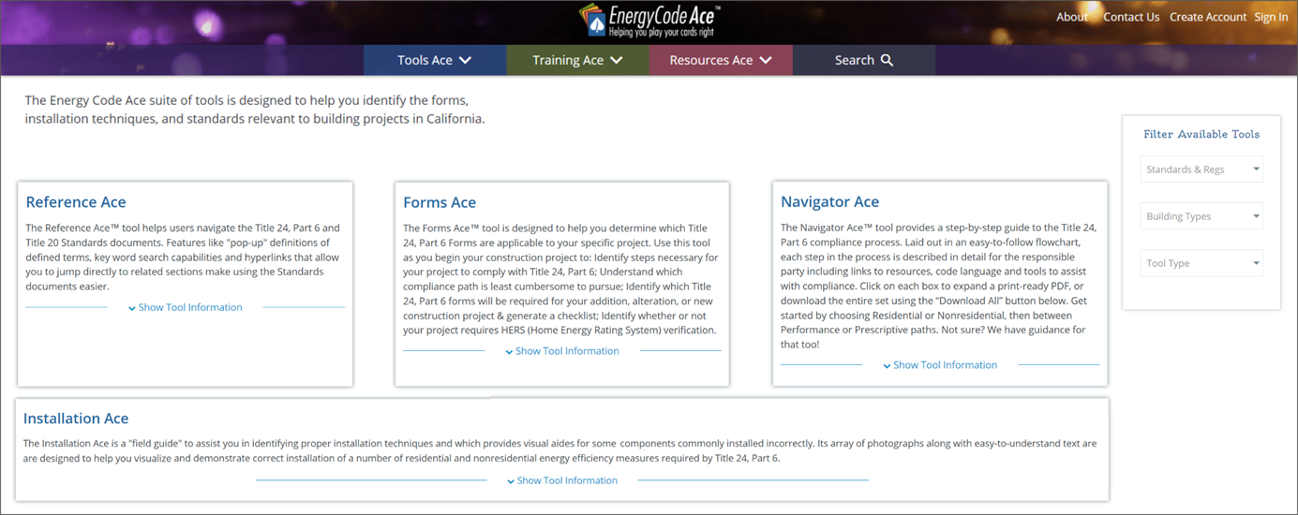
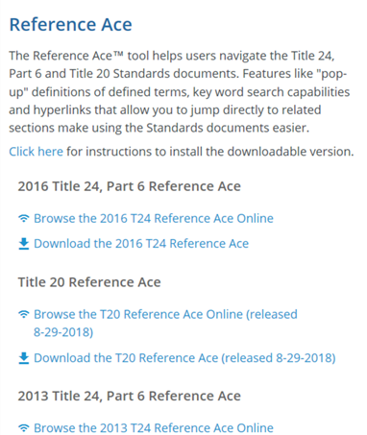
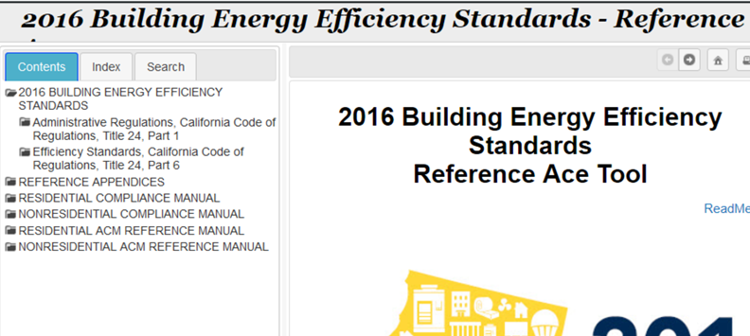
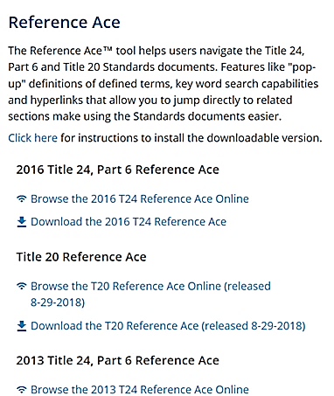
Example of using a tool
5 – 7
What controls are required for nonresidential space conditioning systems?
Use the Reference Ace Table of Contents
1
2
1) Go to the Tools section
3
2) Click “Show Tool…” for the Reference Ace entry
3) Select “Browse…” for Title 24, Part 6
4
4) Click “Efficiency Standards…” in Table
of Contents

Slide 6
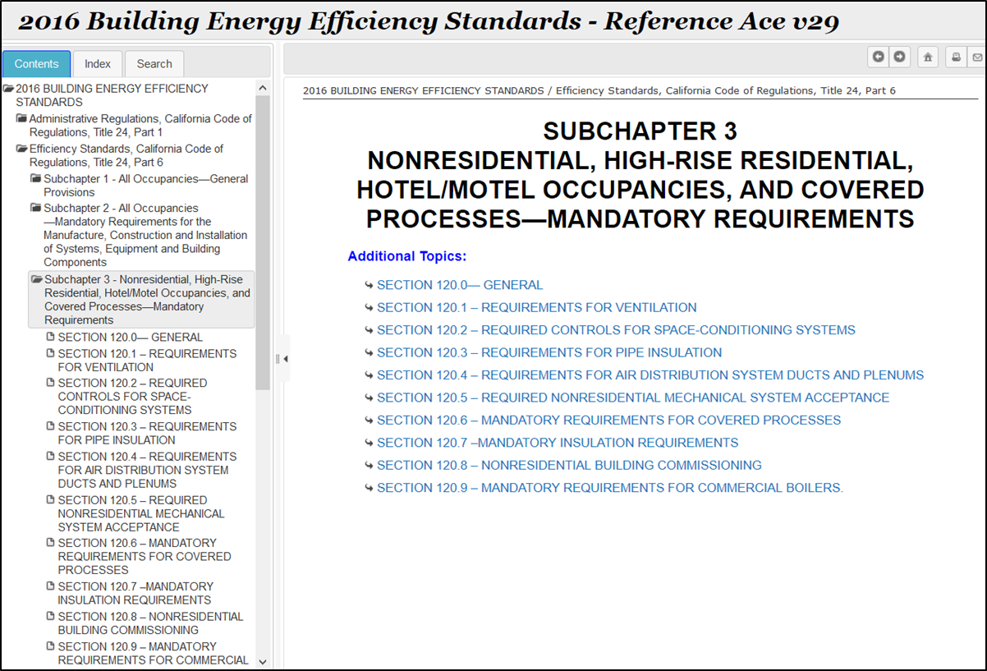
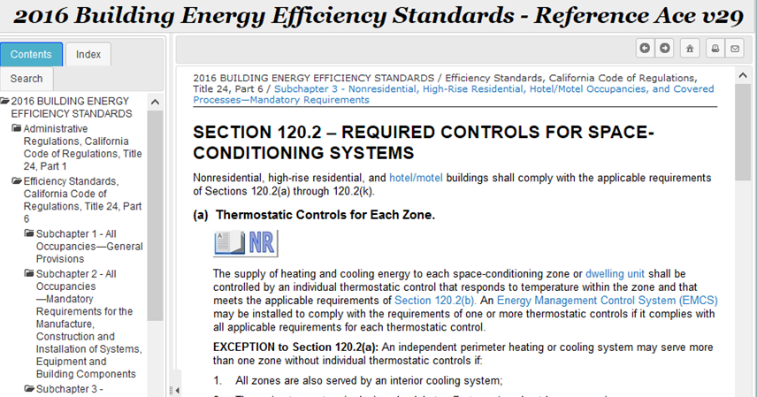
Example of using a tool (cont.)
5 – 7
What controls are required for nonresidential space conditioning systems?
5
6
When you click a section of the Contents it expands to show subsections
5) Select “Subchapter 3 – Nonresidential… Mandatory Requirements”
6) Click “Section 120.2 – Required Controls for Space Conditioning Systems” in the body of the tool.
Scroll through to find what you want
Use hyperlinks to see definitions of key terms or go to related sections

Slide 7
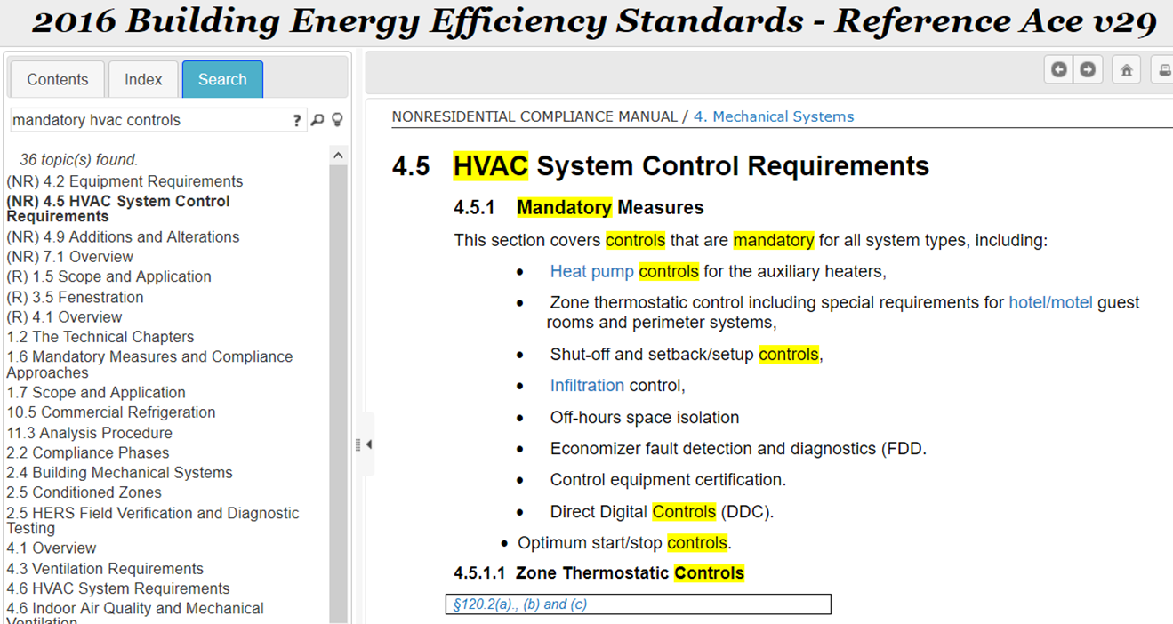
Example of using a tool (cont.)
5 – 7
What controls are required for nonresidential space conditioning systems?
Alternatively, use the Reference Ace Search function
Click the “Search” tab in the navigation pane
Enter the relevant key words
Select the entry you’re interested in
Note the highlighted text in the body of the tool

Slide 8





Summary of Training
8 – 9
Live — in-person and online
Interact with instructor and work with peers
Roll up your sleeves and apply what you’ve learned
Earn CEUs from AIA, CABEC, and ICC
In-person: half-day and full-day session
Online: three- to nine-hours in one to three sessions
Learn from the experts; explore today’s hot topics
Get answers to your questions; see how it’s done by experienced pros
Decoding Talks: Two-hour interactive webinars
Code & Coffee: One-hour broadcasts on our YouTube channel

Slide 9

Summary of Training (cont.)
8 – 9
On-demand — online
Work at your own pace on your own schedule
Check your understanding of key facts and concepts
Earn CEUs from AIA, CABEC, and ICC
Two to five hours for “typical” student
Review recordings of live sessions whenever you want, at your own pace
Refer to Decoding Talks handouts for a quick check on key points

Slide 10
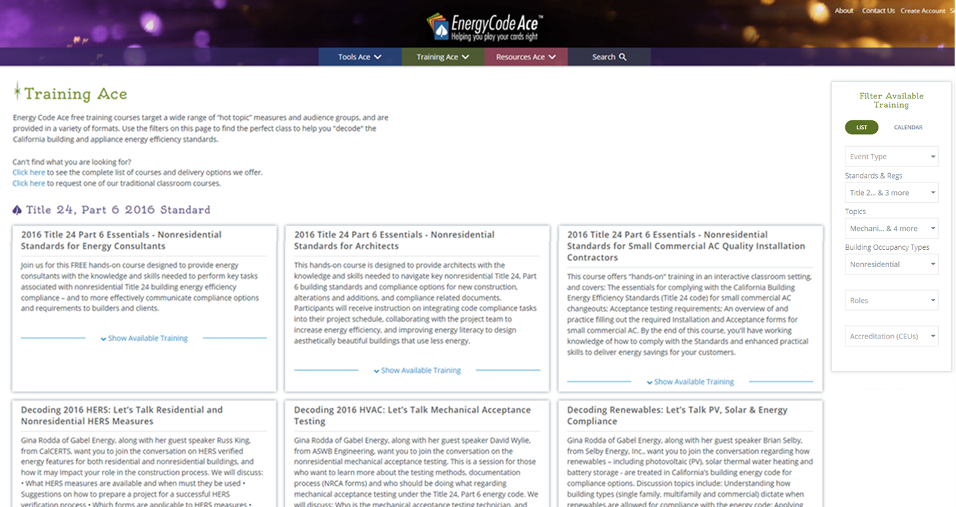



Example of finding training
13 – 14
What training can help me learn about Nonres Mechanical issues?
Filter the list of available training
1
2
3
4
Filter options are:
Event Type
Standards & Regs
Topics
Building Types
Roles
Accreditation (CEUs)
1) Go to the Training section
2) Filter Standards & Regs for “Title 24, Part 6. 2016 Standards”
3) Filter Topics for “Mechanical”
4) Filter Building Types for “Nonresidential”

Slide 11
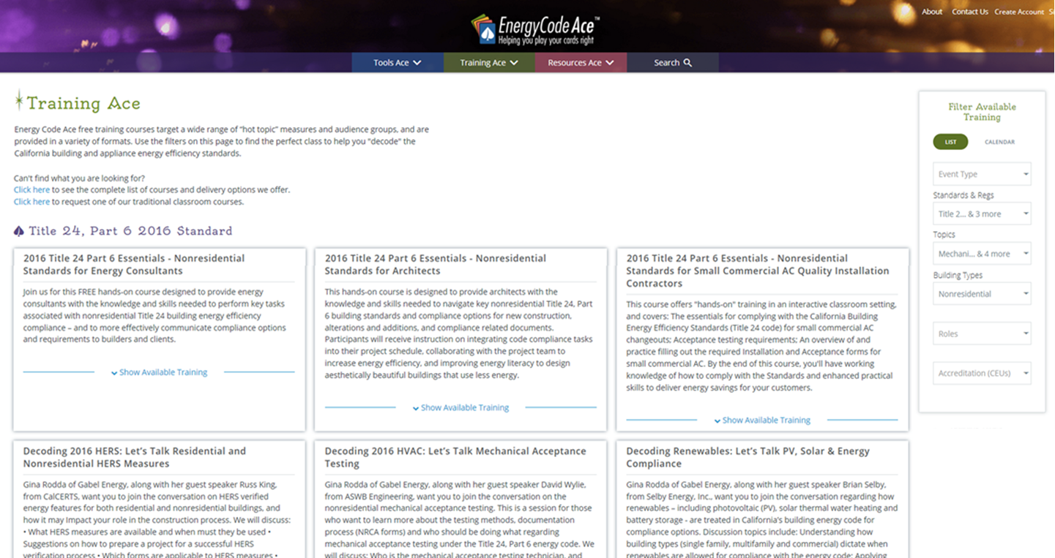
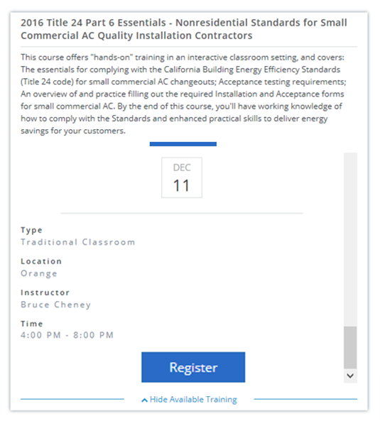
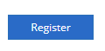
Example of finding training (cont.)
13 – 14
What training can help me learn about Nonres Mechanical issues?
6
5
5) Scroll through the listing.
Click “Show Available Training” for courses you might want
6) Review the description and:
For live, view dates and locations and click “Register”
For on-demand, click “Take the Online Self-study” or view recording (and handout) of past Decoding Talks or Code & Coffee

Slide 12
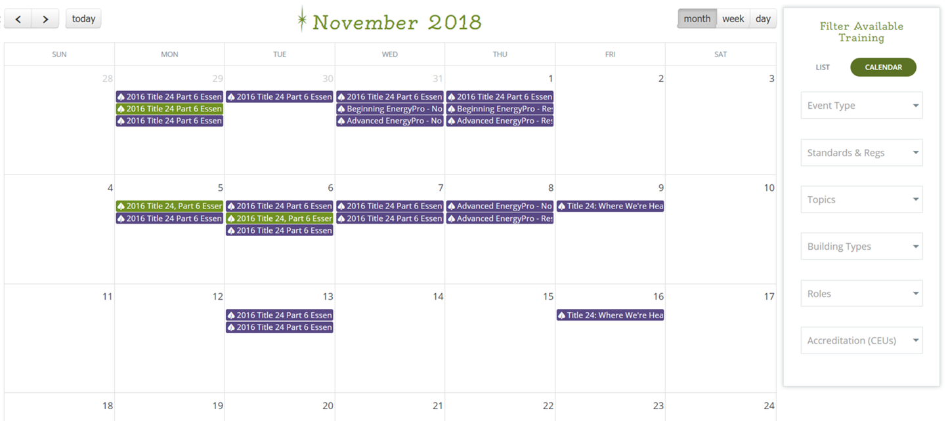
Example of finding training (cont.)
13 – 14
What training can help me learn about Nonres Mechanical issues?
Alternatively, use the Calendar to see available live training
View by month, week or day
Click the “Calendar” tab (above the Filters)
Use the arrow keys (upper left) to change months
Filter options are the same as in “List” view
Click on colored boxes to see course details and register

Slide 13



Summary of Resources
16 – 19
55 to 100+ pages of guidance
Essential concepts and principles
Technology and systems alternatives
Compliance requirements and strategies
Recommendations for alternative scenarios
2 to 8 pages of “just the facts”
Roles, responsibilities and requirements
Relevant code sections
Relevant compliance documentation
Topic highlights and sources for more info
2 to 5 pages of summary guidance for alterations
Which parts of code are triggered when various components are changed
Mandatory, Prescriptive or Performance
Relevant code sections

Slide 14



Summary of Resources (cont.)
16 – 19
Short guides to what building departments look for
Questions Plans Examiners and Building Inspectors typically ask re Title 24, Part 6
Summary of relevant forms
References to relevant code sections
Dynamic resource to summarize what’s mandatory
Mandatory Measures for given project based on your answers
Exceptions and your notes listed on request
Printable to include with project documentation
Guidance for those who design, specify, install or inspect nonresidential lighting installations
What lighting controls are required
Area Category lighting power density (LPD) allowances
See page 19 in your handout for info on how to order your Lighting Wheel

Slide 15
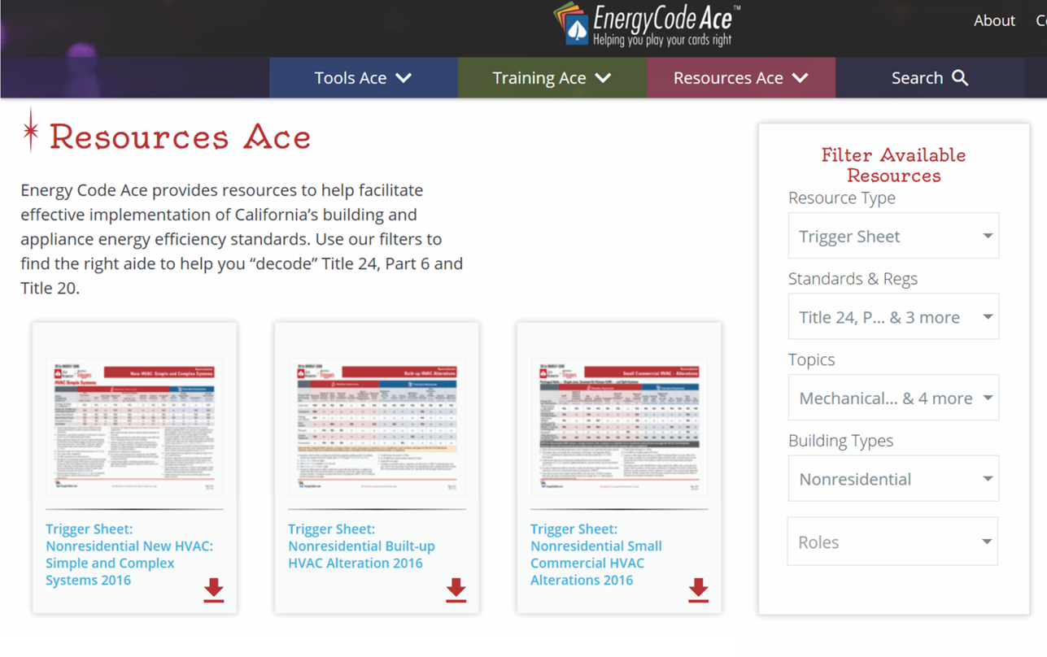




Example of finding a resource
20 – 21
We’re replacing our package unit cooling coil… What code applies?
Filter the list of available resources
1
2
3
4
1) Go to the Resources section
5
2) Filter Resource Type for “Trigger Sheet”
3) Filter Standards & Regs for “Title 24, Part 6”
Filter options are:
Resource Type
Standards & Regs
Topics
Building Types
Roles
4) Filter Topics for “Mechanical”
5) Filter Building Types for “Nonresidential”

Slide 16
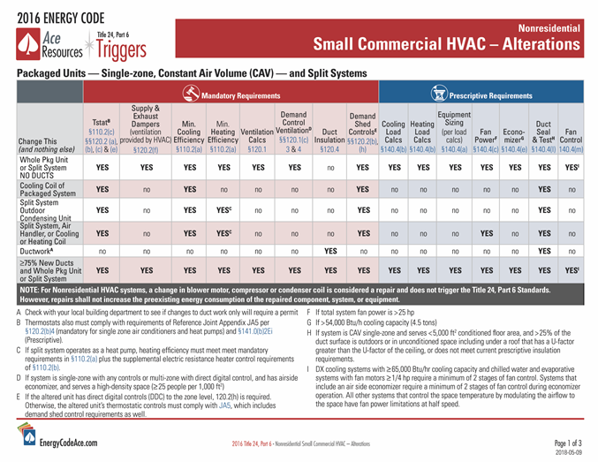
Example of finding a resource (cont.)
20 – 21
We’re replacing our package unit cooling coil; what code applies?
Review the resulting titles and select the one that best fits your question (Nonresidential Small Commercial HVAC Alterations)
6
6) Click the red arrow to open the Trigger Sheet

Slide 17
So many options… where do you start?
22
SHOW ALL AT ONCE
When you want…
Where do you look?
A comprehensive look at an area to understand alternatives
Application Guide
Traditional class, v-class, vorkshop, online self-study (OLSS)
A deep dive on a specific area and how it applies to you
Application Guide
Traditional class, v-class, vorkshop, OLSS, Decoding Talk, Code & Coffee
The big picture of a process or measure
Fact Sheet
Application Guide
Tips for finding compliant product
Application Guide
Info on roles, responsibilities and documentation for all project phases
Navigator Ace
Application Guide
Fact Sheet
Guidance on complete, correct compliance documentation
Forms Ace
Fact Sheet
Application Guide

Slide 18
So many options… where do you start? (cont.)
22
SHOW ALL AT ONCE
When you want…
Where do you look?
A quick summary of relevant code requirements
Fact Sheet (New and Alterations)
Triggers Sheet (Alterations)
The details on the code or exact code verbiage
Reference Ace
Answer to “If I change this, what parts of the code do I need to be concerned with?”
Triggers Sheet
A summary of forms required for a project
Forms Ace
Fact Sheet or Triggers Sheet
A look at what enforcement agency personnel check for
Plans Examiner Checklist
Building Inspector Checklist
Installation Ace
Help ensuring your project addresses relevant mandatory measures
Note Blocks (Nonres only at this time)
Triggers Sheet

Slide 19
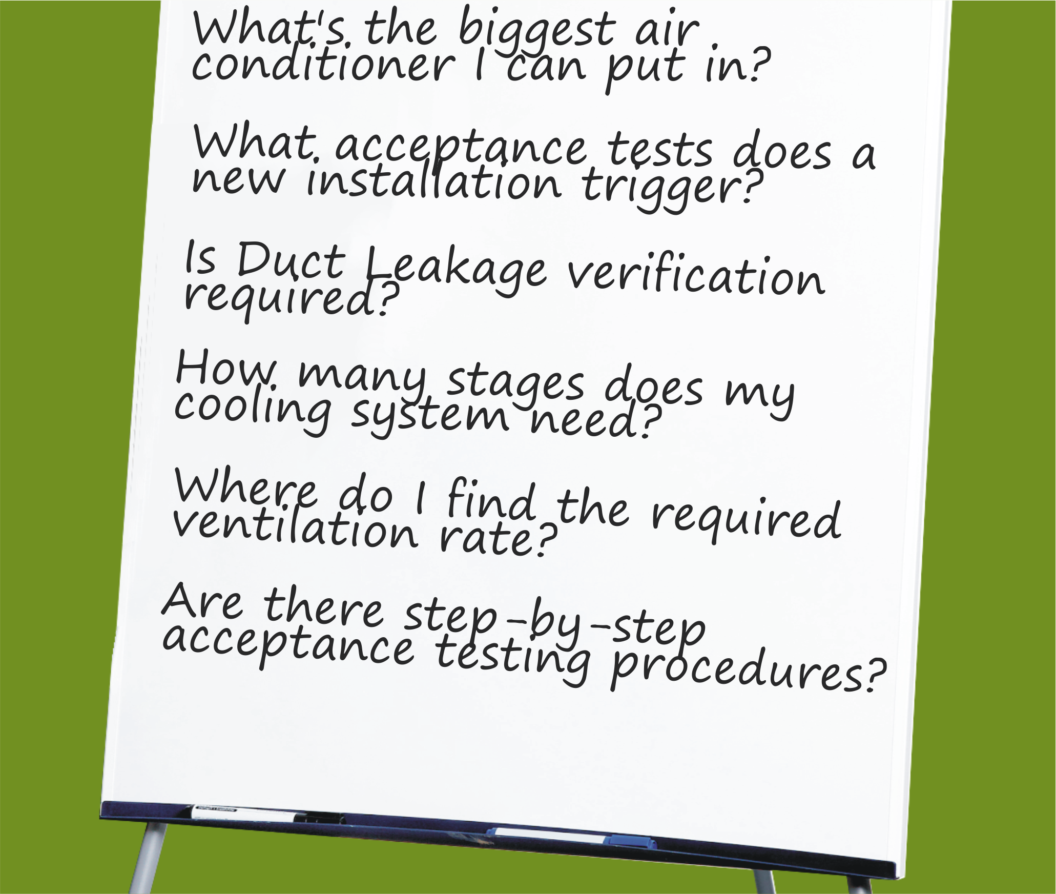

What Questions Do You Want Answered?
Track Specific

Slide 20
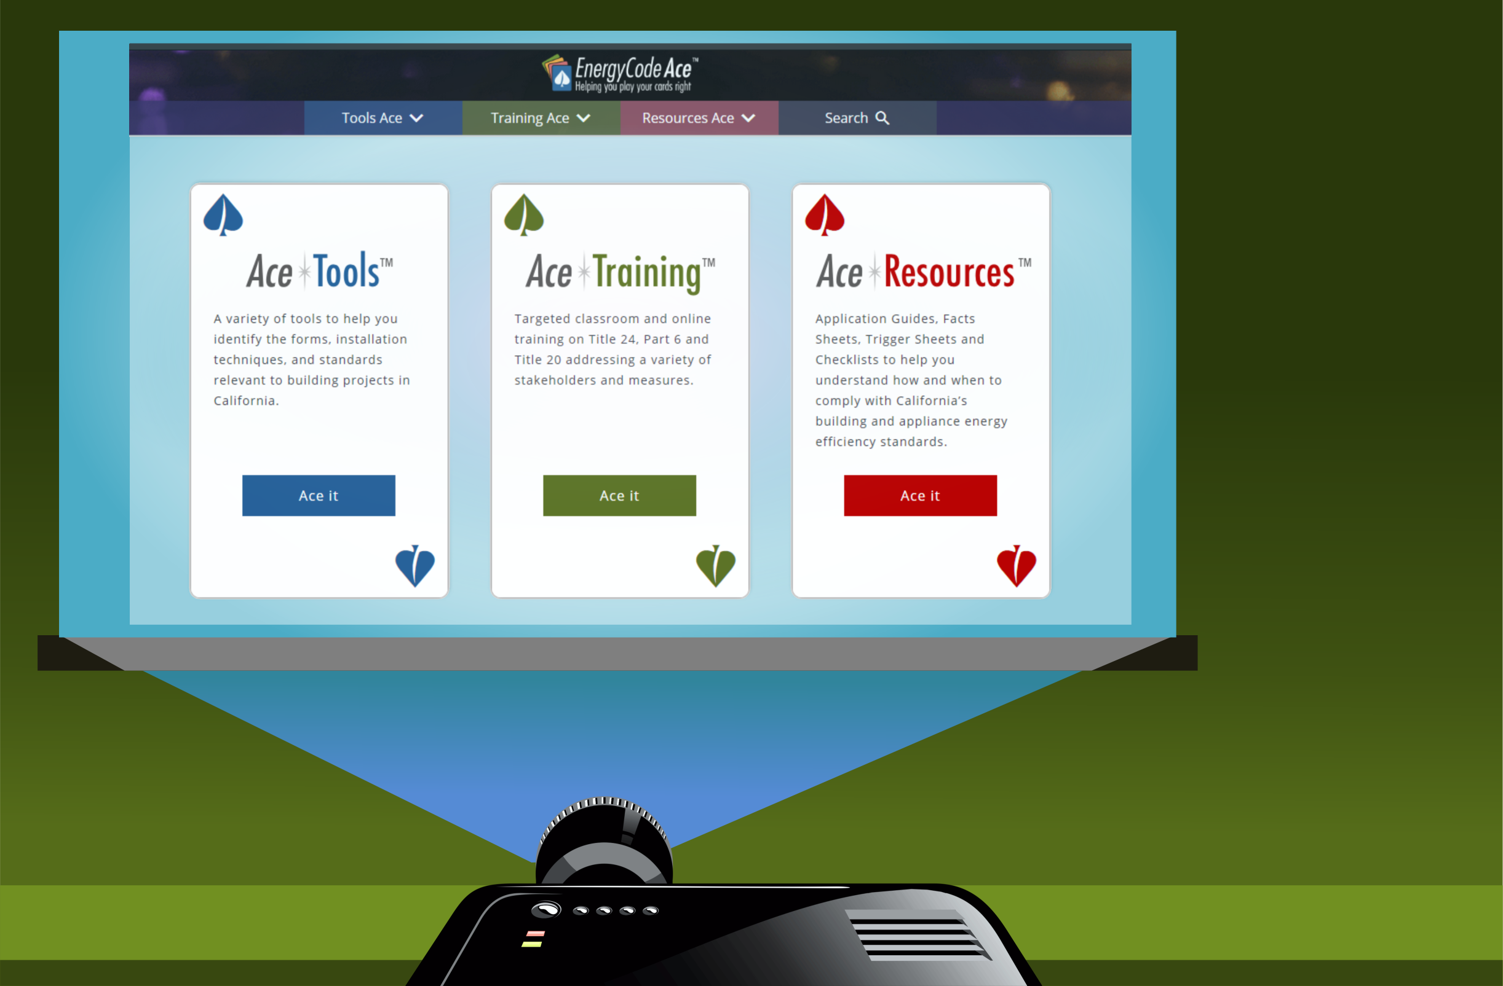

Let’s show you how to get some answers…

Slide 21

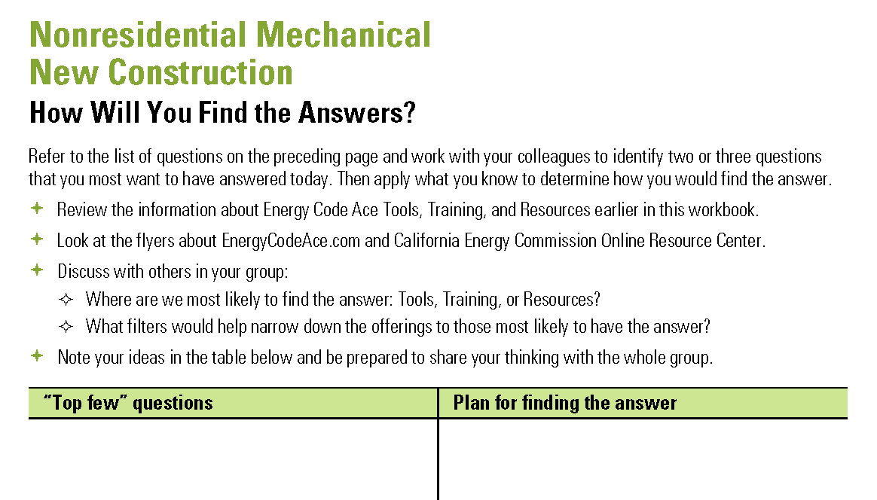
What Questions Do You Want Answered?
Track Specific
Work with your group to:
Identify “top few” questions you want answered
Plan where to find the answers
  Tools, Training, Resources?
  The filters to narrow your search?
Note your ideas in the Nonres Mechanical worksheet in your handout
Be prepared to share your group’s thinking with the whole group

Slide 22
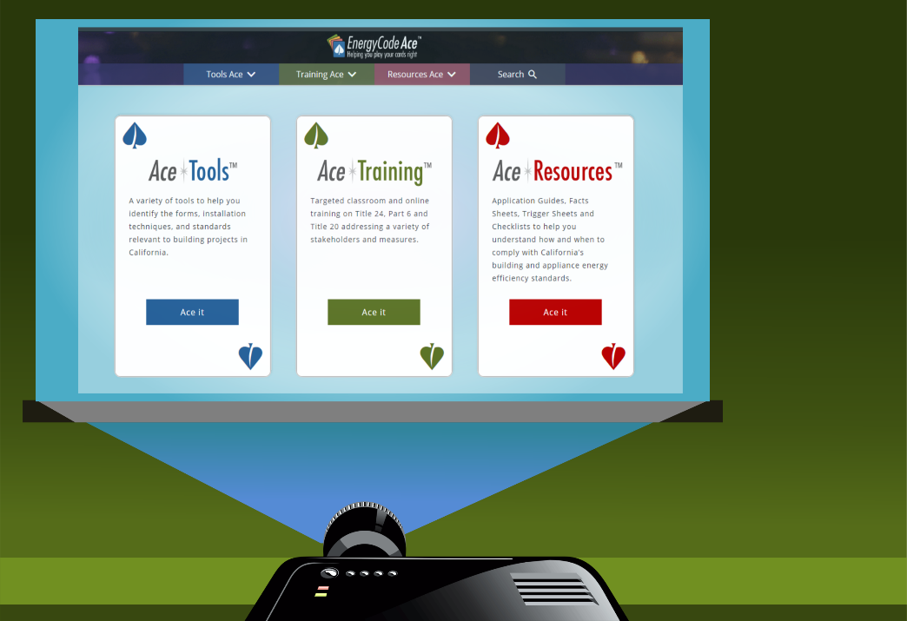

Let’s go fishing…
What is your group’s top question?
Where do you think we’ll find the answer?
  (Tell me how to get there, please.)

Slide 23

Conclusion
Anything before we go?
Questions?
Suggestions?
General comments?

Slide 24

Thank you for your participation!
Contact | Role | Email | Phone
Bruce Cheney | Instructor | Bruce@aae-hers.com | 858-254-1189
David Wylie | Instructor | dwylie@aswb-engineering.com | 714-731-8193
Jill Marver | PG&E | jkz1@pge.com | 925-415-6844
Ruby Yepez | SCE | Ruby.R.Yepez@sce.com | 626-302-0699
Jeremy Reefe | Sempra | JMReefe@semprautilities.com | 858-636-5533
Ray Mendoza | Sempra | RJMendo1@semprautilities.com | 562-803-7493
Notes:
***** Instructor Only *****
Before class: Please edit the title slide to include your name and organization.
***** End Instructor Only *****

Slide 25
So many options… where do you start?
22
NEXT
When you want…
Where do you look?
A comprehensive look at an area to understand alternatives
Application Guide
Traditional class, v-class, vorkshop, online self-study (OLSS)
A deep dive on a specific area and how it applies to you
Application Guide
Traditional class, v-class, vorkshop, OLSS, Decoding Talk, Code & Coffee
The big picture of a process or measure
Fact Sheet
Application Guide
Tips for finding compliant product
Application Guide
Info on roles, responsibilities and documentation for all project phases
Navigator Ace
Application Guide
Fact Sheet
Guidance on complete, correct compliance documentation
Forms Ace
Fact Sheet
Application Guide

Slide 26
So many options… where do you start? (cont.)
22
NEXT
When you want…
Where do you look?
A quick summary of relevant code requirements
Fact Sheet (New and Alterations)
Triggers Sheet (Alterations)
The details on the code or exact code verbiage
Reference Ace
Answer to “If I change this, what parts of the code do I need to be concerned with?”
Triggers Sheet
A summary of forms required for a project
Forms Ace
Fact Sheet or Triggers Sheet
A look at what enforcement agency personnel check for
Plans Examiner Checklist
Building Inspector Checklist
Installation Ace
Help ensuring your project addresses relevant mandatory measures
Note Blocks (Nonres only at this time)
Triggers Sheet

Slide 27
Thank you for your participation!
Contact | Role | Email | Phone
Martyn Dodd | Instructor | Mart@energysoft.com | 415-897-6400
Gina Rodda | Instructor | gina@gabelenergy.com | 510-428-0803
Brian Selby | Instructor | brian@selbyenergyinc.com | 209-352-2281
Marina Blanco | Instructor | marina@gabelenergy.com | 510-428-0803
Jill Marver | PG&E | jkz1@pge.com | 925-415-6844
Ruby Yepez | SCE | Ruby.R.Yepez@sce.com | 626-302-0699
Jeremy Reefe | Sempra | JMReefe@semprautilities.com | 858-636-5533
Ray Mendoza | Sempra | RJMendo1@semprautilities.com | 562-803-7493
Notes:
***** Instructor Only *****
Before class: Please edit the title slide to include your name and organization.
***** End Instructor Only *****

