Slide 1

What’s New for 2019:
Highlights!
Notes:
I’m today’s spokesperson …speaking on behalf of my counterparts:
Adrian Salas
Javier Mariscal and Gary Shushnar
Dipo

Slide 2
2019 Energy Code
Presenter:
Martyn Dodd
  Code Development
    Schedule of Implementation; Where to find
    Performance Software
    Basis and Structure of the Energy Code
All Occupancies
Nonresidential Measures
Residential Measures
Multifamily Measures
Wrap Up

Slide 3

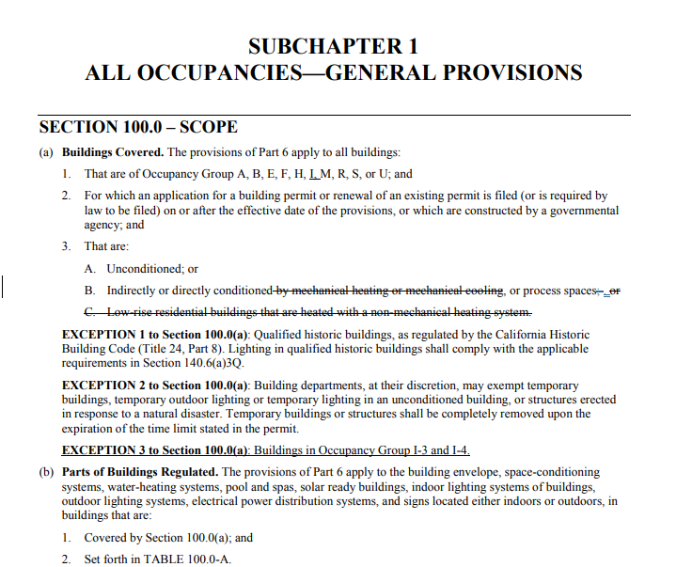

Standards Update Schedule
May 9, 2018 Business Meeting – Language Adoption
Jan 1, 2020 Implementation Date
  Any projects that apply for permit on or after Jan 1, 2020 will be subject to the 2019 Standards
“Revised Express Terms” documents available at:
  http://www.energy.ca.gov/
  title24/2019standards/
Final 2019 Title 24 Part 6 Standards expected to be approved and available January 2019
Strikethrough: Removed language
Underline: Added language

Slide 4
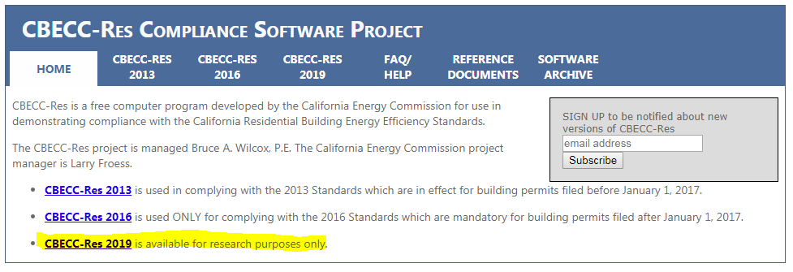
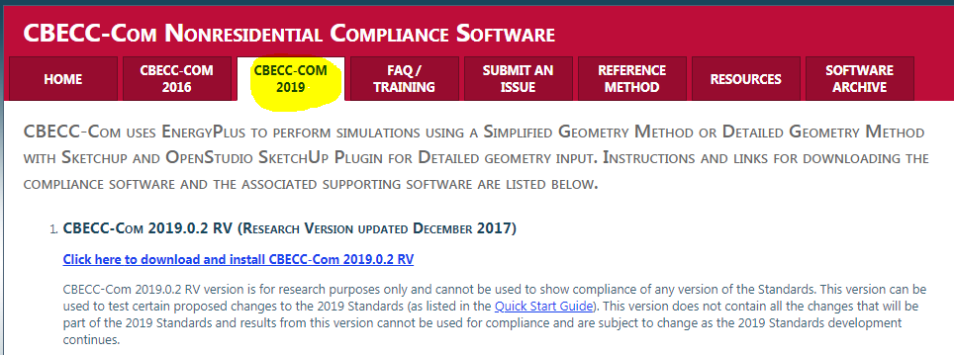
Want to Start Playing Early?
2019 Performance Software
Residential: http://www.bwilcox.com/BEES/cbecc2019.html
Nonresidential: http://bees.archenergy.com/software2019.html

Slide 5

How the Energy Code Measures Energy
Intent Behind the Code
The Warren-Alquist Act, requires the Energy Commission to develop and maintain Building Energy Efficiency Standards that are
  “… cost effective, when taken in their entirety, and when amortized over the economic life of the structure when compared with historic practice”.
Time Dependent Valuation (TDV)
  Gives greater weight to energy saved during peak periods – or periods when the generation capacity is at its limit and when the distribution system is near capacity.

Slide 6

2019 Energy Code
Presenter:
Martyn Dodd
Code Development
  All Occupancies
Nonresidential Measures
Residential Measures
Multifamily Measures
Wrap Up
All Occupancies
Title 24 Part 1 | Article 1 | Administrative Regulations, California Code of Regulations
Title 24 Part 6 Energy Efficiency Standards
SUBCHAPTER 1 | Section 100.0-100.2 | GENERAL PROVISIONS
SUBCHAPTER 2 | Section 110.0-110.11 | MANDATORY REQUIREMENTS FOR THE MANUFACTURE, CONSTRUCTION AND INSTALLATION OF SYSTEMS, EQUIPMENT AND BUILDING COMPONENTS

Slide 7

Healthcare Facilities
100.0(a)
Institutional Facilities added (Occupancy I-1 & I-2)
I-1 Covers
Alcohol and drug centers
Assisted living facilities
Congregate care facilities
Convalescent facilities
Group homes
Halfway houses
Residential board and custodial care facilities
I-2 Covers
Foster care facilities
Detoxification facilities
Hospitals
Nursing homes
Psychiatric hospitals
Important exemptions are listed in many sections of the code

Slide 8
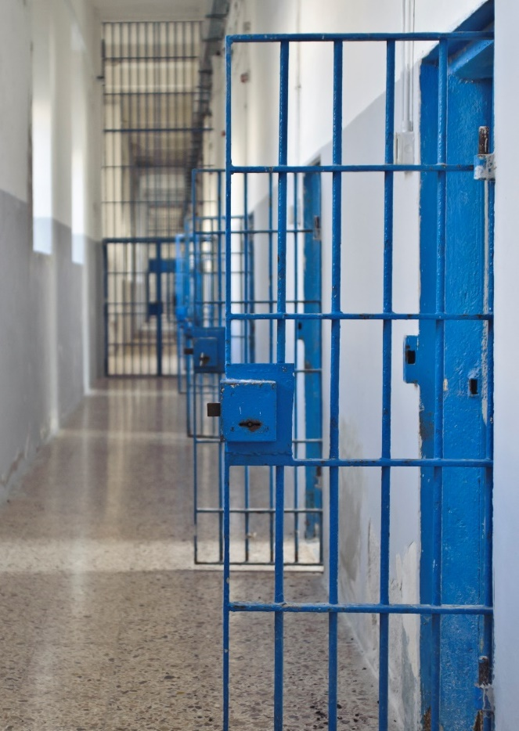
Healthcare Facilities (cont)
100.0(a)
I-3 Exempt
Prisons
Jails Reformatories
Detention Centers
Correctional Centers
Prerelease centers
I-4 Exempt
Daycare facilities

Slide 9
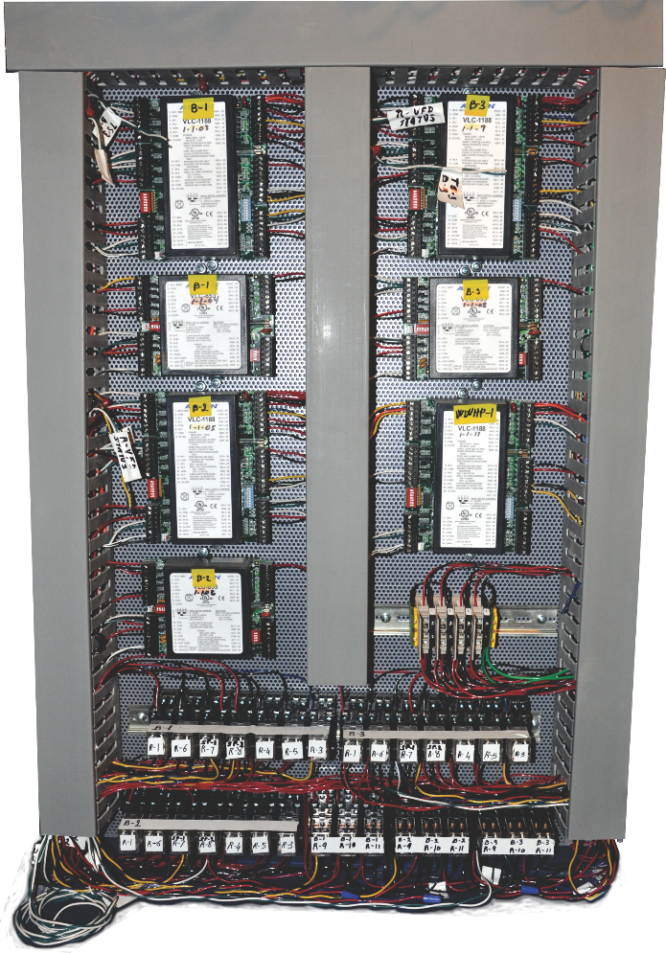
Demand Management
110.12
New code section that consolidates all Demand Response items
  References OpenADR 2.0 protocols
  HVAC controls
  Lighting controls
  Electric message centers

Slide 10
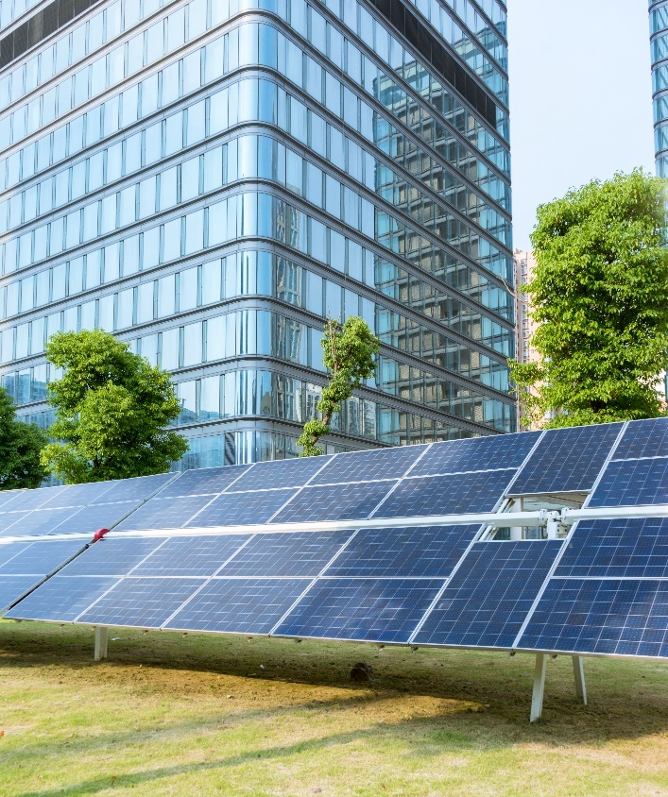
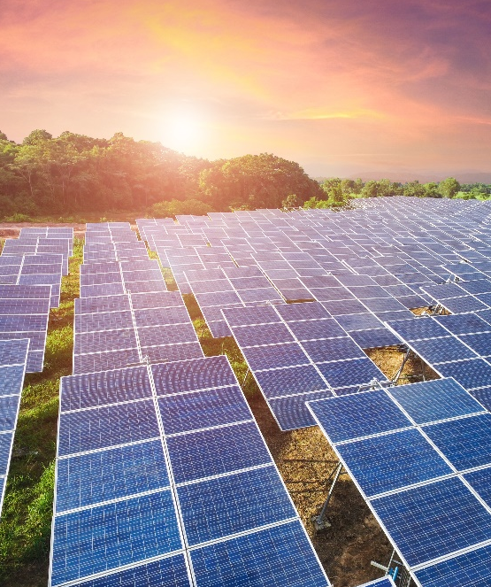
Community Shared Solar or Battery Systems
Large PV Array
10-115
Allows a common shared system to be used to offset solar and/or battery requirements
  Must be operational before final permit signed off on building
  Must provide equivalent or better performance than what is specified for building
  Can feed the Building via the grid
  Must provide benefit to the building for 20 years minimum
  Cannot transfer benefit to another building
  Requires approval from the CEC

Slide 11
And Now It’s Time For Some Sli.do Fun!

Slide 12

Check Your Understanding
1
When does the 2019 Energy Code go into effect?
January 1, 2019
January 1, 2020
January 1, 2021
January 1,
2020

Slide 13


2019 Energy Code
Presenter:
Gina Rodda
Code Development
All Occupancies
  Nonresidential Measures
Residential Measures
Multifamily Measures
Wrap Up
Title 24 Part 6 Energy Efficiency Standards
Nonresidential / High-Rise Multifamily Residential / Hotel & Motel / Covered Process Occupancies
SUBCHAPTER 3 | Section 120.0-120.9 | MANDATORY REQUIREMENTS
SUBCHAPTER 4 | Section 130.0-130.5 | MANDATORY REQUIREMENTS FOR LIGHTING SYSTEMS AND EQUIPMENT, AND ELECTRICAL POWER DISTRIBUTION SYSTEMS
SUBCHAPTER 5 | Section 140.0-140.9 | PERFORMANCE AND PRESCRIPTIVE COMPLIANCE APPROACHES FOR ACHIEVING ENERGY EFFICIENCY
SUBCHAPTER 6 | Section 141.0-141.1 | ADDITIONS, ALTERATIONS, AND REPAIRS

Slide 14
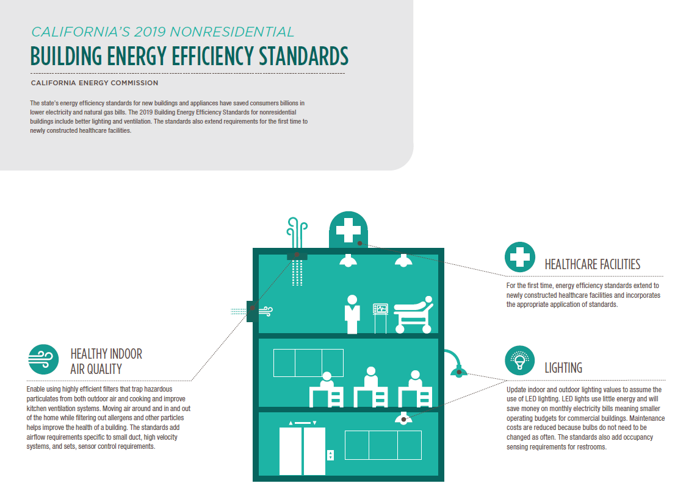
Energy Commission Infographic

Slide 15
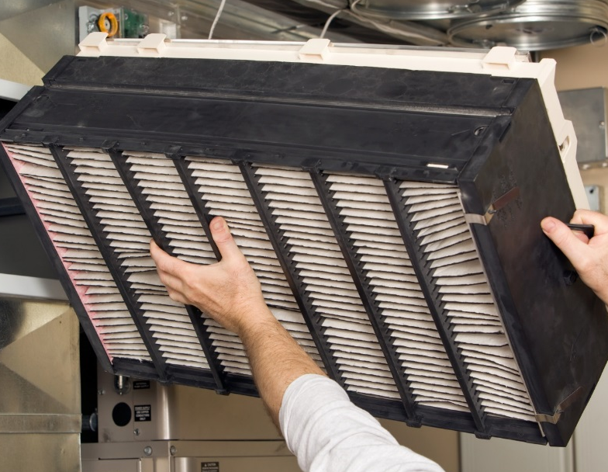
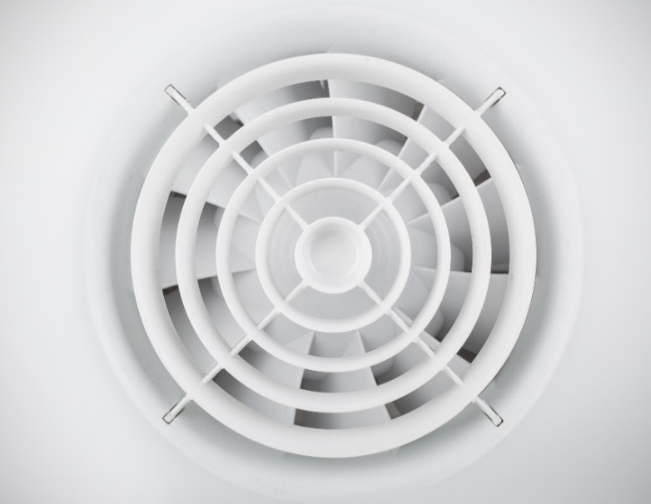
Nonresidential and Hotel/Motel
(Not Multifamily)
120.1
Air Filtration (New)
Min. MERV 13 filtration for outdoor air supply AND
Min. 2” Filter (larger face area formula will allow for 1”)
Ventilation (Major Changes)
Natural Ventilation:
  Must also use mechanical ventilation unless openings are permanently open, or using controls easily accessible to occupant. New requirements on size and location of openings. (new)
Mechanical Ventilation:
  Minimum ventilation to be larger of cfm/ft² per Table 120.1-A or number of occupants. (new table with revised space names but no change to CFM requirements)
ASHRAE 62.1

Slide 16

Nonresidential and Hotel/Motel Ventilation (cont.)
120.1
Air Classification (Air Class) defines air that can be recirculated or transferred to other spaces per Table 120.1-A and C. (new)
  Class 1: Allowed to move around among all classes
  Class 2: Only between Class 1 and 2
  Class 3: Only between other Class 3 spaces
  Class 4: Cannot be recirculated/transferred to any other space
Table 120.1-A – Minimum Ventilation Rates — p. 1 of 6
Table similar to ASHRAE 62.1,
CFM requirements have not changed
Occupancy Category | Area Outdoor Air Rate¹ R_{a} cfm/ft² | Min Air Rate for DCV² cfm/ft² | Air Class | Notes
Educational Facilities
Daycare (through age 4) | 0.21 | 0.15 | 2
Daycare sickroom | 0.15 |  | 3
Classrooms (ages 5-8) | 0.38 | 0.15 | 1
Classrooms (age 9 -18) | 0.38 | 0.15 | 1
Lecture/postsecondary classroom | 0.38 | 0.15 | 1 | F
Lecture hall (fixed seats) | - | 0.15 | 1 | F
Art classroom | 0.15 |  | 2
Science laboratories | 0.15 |  | 2
University/college laboratories | 0.15 |  | 2
Wood/metal shop | 0.15 |  | 2
Computer lab | 0.15 |  | 1
Media center | 0.15 |  | 1 | A

Slide 17
Nonresidential and Hotel/Motel Ventilation (cont.)
140.4(o)
120.1
Exhaust Ventilation: New
  Min. required per Table 120.1-B
  Exhaust makeup air can use combination of
    Outdoor air AND/OR
    Recirculated air AND/OR
    Transfer air.
Exhaust Transfer Air: New
  Supply air shall not exceed:
    Required to meet heating/cooling loads; OR
    Meet designed ventilation rate: OR
    Supply = Exhaust flow – transfer air. Transfer air allowed to be used has requirements.
  Also applies to Lab and Factory systems
Table 120.1-B – Minimum Exhaust Rates [ASHRAE 62.1: TABLE 6.5] — p. 1 of 2
Occupancy Category | Exhaust Rate, cfm/unit | Exhaust Rate, cfm/ft² | Air Class | Notes
Arenas | - | 0.50 | 1 | B
Art classrooms | - | 0.70 | 2
Auto repair rooms | - | 1.5 | 2 | A
Barber shops | - | 0.50 | 2
Beauty and nail salons | - | 0.60 | 2
Cells with toilet | - | 1.00 | 2
Based on ASHRAE 62.1

Slide 18
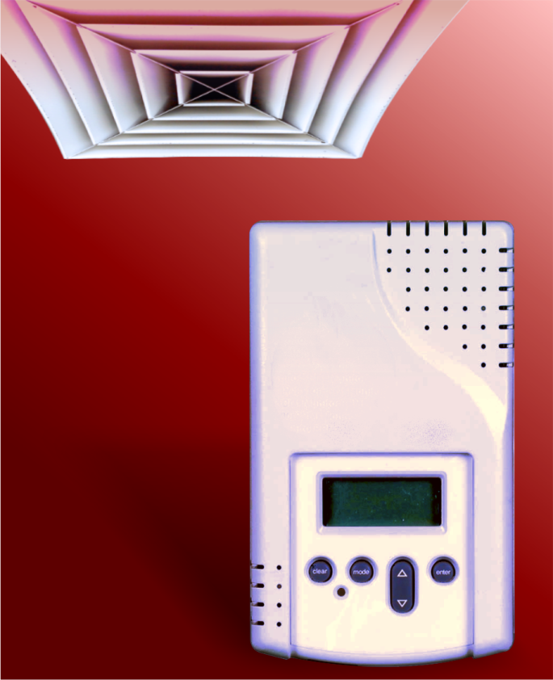
Demand Control Ventilation
120.1(d)3
Typically a CO₂ sensor, will be required when:
  A high density spaces now identified on Table 120.1-A AND
    System has an outside air economizer or
    Modulating outside air control (new) or
    System has Outside Air >3,000 cfm. (new)
Many exceptions removed such as:
  Classrooms (they now must provide if triggered)
  Occupancy sensor ventilation control was required (now you might need both demand and occupancy sensor control).
Space type exceptions expanded, such as:
  Daycare Sickrooms
  Science Labs
  Barber Shops
  Beauty and nail salons
Occupancy Category | Area Outdoor Air Rate¹ R_{a} cfm/ft² | Min Air Rate for DCV² cfm/ft² | Air Class | Notes
Educational Facilities
Daycare (through age 4) | 0.21 | 0.15 | 2
Daycare sickroom | 0.15 |  | 3
Classrooms (ages 5-8) | 0.38 | 0.15 | 1
Classrooms (age 9 -18) | 0.38 | 0.15 | 1
Lecture/postsecondary classroom | 0.38 | 0.15 | 1 | F
Lecture hall (fixed seats) | - | 0.15 | 1 | F
Art classroom | 0.15 |  | 2
Science laboratories | 0.15 |  | 2
University/college laboratories | 0.15 |  | 2
Wood/metal shop | 0.15 |  | 2
Computer lab | 0.15 |  | 1
Media center | 0.15 |  | 1 | A

Slide 19
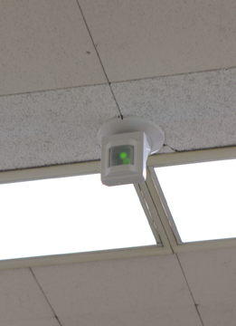
Occupancy Sensor Ventilation Control
120.1(d)5
120.2(e)3
Required for the same spaces in which lighting occupancy sensor controls are required (§130.1(c)5) (no change)
  Offices 250 ft² or smaller,
  Multipurpose rooms of less than 1,000 ft²
  Classrooms of any size,
  Conference rooms of any size, and
  Restrooms of any size (new).
If the ventilation Table 120.1-A does not allow for the ventilation to go to ZERO, then the room type is exempt (new)
Thermostat settings to be reset to “standby mode” when space vacant more than 5 minutes (new).
The exception to use demand control ventilation controls instead in these spaces, has been removed.

Slide 20
Nonresidential Indoor Lighting

Slide 21
Area Category Lighting Allowances
140.6-c
Table 140.6-C Area Category Method — Lighting Power Density Values (Watts/Ft²) — p. 1 of 3
Primary Function Area |  | Allowed LPD (W/ft²) |  | % Reduction | Additional Lighting Power¹ |  |  | % Reduction
 |  |  |  |  | Qualified Lighting System | Additional Allowance (W/ft²)
 |  | 2016 | 2019 |  |  | 2016 | 2019
Auditorium Area |  | 1.40 | 0.70 | 50% | Ornamental | 0.50 | 0.30 | 40%
 |  |  |  |  | Accent, display and feature³ | --- | 0.20 | -
Auto Repair / Maintenance Area |  | 0.90 | 0.55 | 39% | Detailed Task Work⁷ | 0.50 | 0.20 | 60%
Audience Seating Area (New) |  | --- | 0.60 | - | Ornamental | --- | 0.30 | -
Beauty Salon Area |  | 1.70 | 0.80 | 53% | Detailed Task Work⁷ | --- | 0.20 | -
 |  |  |  |  | Ornamental | --- | 0.30 | -
Civic Meeting Place Area |  | 1.30 | 1.00 | 23% | Ornamental | 0.50 | 0.30 | 40%
Classroom, Lecture, Training, Vocational Areas |  | 1.20 | 0.70 | 33% | White or Chalk Board¹ | 5.5 w/ft | 4.5 w/ft | 18%
Commercial / Industrial Storage (Modified) | Warehouse | 0.60 | 0.45 | 25% | --- | --- | --- | -
 | Shipping & Handling | --- | 0.60 | - | --- | --- | --- | -
Commercial and Industrial Storage Areas (Refrigerated) |  | 0.70 | --- | - | --- | --- | --- | -
Convention, Conference, Multipurpose and Meeting Area |  | 1.20 | 0.85 | 29% | Ornamental | 0.50 | 0.30 | 40%
Copy Room (Separate Category) |  | --- | 0.50 | - | --- | --- | --- | -
Corridor Area (Separate Category) |  | 0.60 | 0.60 | 0% | --- | --- | --- | -
Dining Area | Bar/Lounge and Fine Dining | 1.00 | 0.55 | 45% | Ornamental | 0.50 | 0.30 | 40%
 | Cafeteria / Fast Food | 1.00 | 0.40 | 60% | --- | --- | --- | -
 | Family and Leisure | 1.00 | 0.50 | 50%
Electrical, Mechanical, Telephone Rooms |  | 0.55 | 0.40 | 28% | Detailed Task Work⁷ | 0.50 | 0.20 | 60%
Exercise / Fitness Center and Gymnasium Areas |  | 1.00 | 0.50 | 50% | --- | --- | --- | -
Hotel Function Area (New) |  | --- | 0.85 | - | Ornamental | --- | 0.30 | -
Museum | Exhibition / Display | 1.8 | 0.60 | 67% | Accent, display and feature³ | --- | 0.50 | -
 | Restoration Room (New) | --- | 0.75 | - | Detailed Task Work⁷ | --- | 0.20 | -
Financial Transaction Area |  | 1.00 | 0.80 | - | Ornamental | 0.50 | 0.30 | 40%
General / Commercial and Industrial Work Areas | Low Bay | 0.90 | 0.60 | 33% | Detailed Task Work⁷ | 0.50 | 0.20 | 60%
 | High Bay | 1.00 | 0.65 | 35% | Detailed Task Work⁷ | 0.50 | 0.20 | 60%
 | Precision | 1.20 | 0.85 | 29% | Precision Specialized Work⁹ | 1.00 | 0.70 | 30%
Library | Reading Area | 1.10 | 0.80 | 27% | Ornamental | 0.50 | 0.30 | 40%
 | Stacks Area | 1.50 | 1.10 | 27% | Ornamental | 0.50 | --- | 100%
Main Entry Lobby (Modified) |  | 0.95 | 0.85 | 11% | Ornamental | 0.50 | 0.30 | 40%
Locker Room |  | 0.70 | 0.45 | 36% | --- | --- | --- | -
Lounge, Breakroom or Waiting Areas (Modified) |  | 0.90 | 0.65 | 28% | Ornamental | 0.50 | 0.30 | 40%
Malls Concourse and Atria Area (Modified) |  | 0.95 | 0.90 | 5% | Ornamental | 0.50 | 0.30 | 40%
Reduced ≈ 31%
Aligning with ASHRAE 90.1

Slide 22
Outdoor Lighting

Slide 23
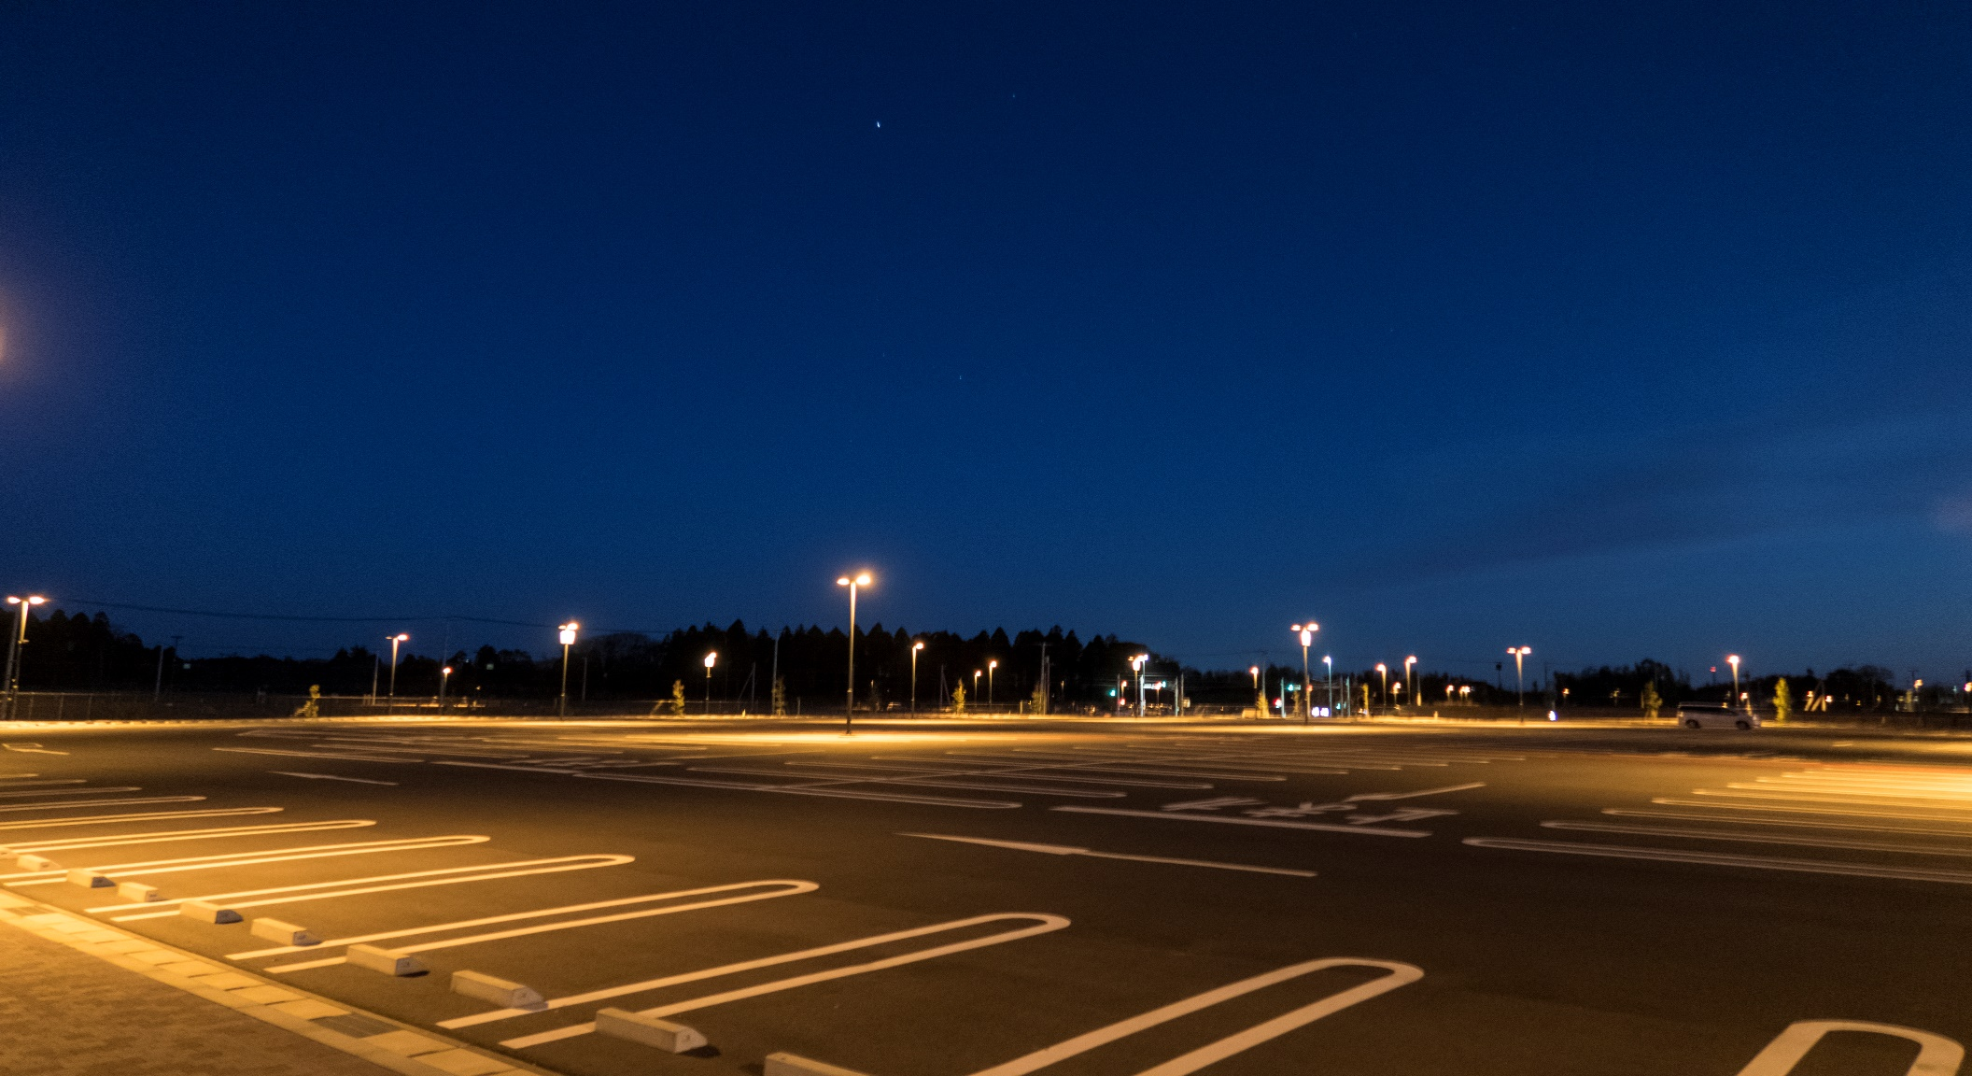
New General Hardscape Allowances
140.7
Table 140.7-A: General Hardscape Lighting Power Allowance
Type of Power Allowance | Lighting Zone 0³ |  | Lighting Zone 1 ³ |  | Lighting Zone 2 ³ |  |  |  | Lighting Zone 3³ |  |  |  | Lighting Zone 4³
 | 2016 | 2019 | 2016 | 2019 | 2016 |  | 2019 |  | 2016 |  | 2019 |  | 2016 | 2019
 |  |  |  |  | Asphalt | Concrete² | Asphalt | Concrete² |  |  | Asphalt | Concrete²
 |  |  |  |  | Asphalt | Concrete² |  |  | Asphalt | Concrete²
Area Wattage Allowance (AWA) | No allow-ance¹ |  | 0.020 W/ft² | 0.018 W/ft² | 0.030 W/ft² | 0.035 W/ft² | 0.023 W/ft² | 0.025 W/ft² | 0.030 W/ft² | 0.040 W/ft² | 0.025 W/ft² | 0.030 W/ft² | 0.050 W/ft² | 0.030 W/ft²
Linear Wattage Allowance (LWA) |  |  | 0.15 W/lf | 0.15 W/lf | 0.25 W/lf | 0.70 W/lf | 0.17 W/lf | 0.40 W/lf | 0.35 W/lf | 0.70 W/lf | 0.25 W/lf | 0.40 W/lf | 0.45 W/lf | 0.35 W/lf
Initial Wattage Allowance (IWA) |  |  | 340 W | 180 W | 450 W |  | 250 W |  | 520 W |  | 350 W |  | 640 W | 400 W
Reduced ≈ 35%
Continuous lighting is explicitly prohibited in Lighting Zone 0. A single luminaire of 15 Watts or less may be installed at an entrance to a parking area, trail head, fee payment kiosk, outhouse, or toilet facility, as required to provide safe navigation of the site infrastructure. Luminaires installed in Lighting Zone 0 shall meet the maximum zonal lumen limits as specific in §130.2(b).
Where greater than 50% of the paved surface of a parking lot is finished with concrete. This does not extend beyond the parking lot, and does not include any other General Hardscape areas.
Narrow band spectrum light sources with a dominant peak wavelength greater than 580 nm – as mandated by local, state, or federal agencies to minimize the impact on local, active professional astronomy or nocturnal habitat of specific local fauna, shall be allowed a 2.0 lighting power allowance multiplier. (new)

Slide 24
2019 Energy Code
Presenter:
Brian Selby
Code Development
All Occupancies
Nonresidential Measures
  Residential Measures
    Overview
      Building Feature Specific
Multifamily Measures
Wrap Up
Title 24 Part 6 Energy Efficiency Standards
Low-Rise Residential (including single family and low-rise multifamily) Occupancies
SUBCHAPTER 7 | Section 150.0 | MANDATORY FEATURES AND DEVICES
SUBCHAPTER 8 | Section 150.1 | PERFORMANCE AND PRESCRIPTIVE COMPLIANCE APPROACHES
SUBCHAPTER 9 | Section 150.2 | ADDITIONS AND ALTERATIONS TO EXISTING LOW-RISE RESIDENTIAL BUILDINGS

Slide 25
New Construction

Slide 26
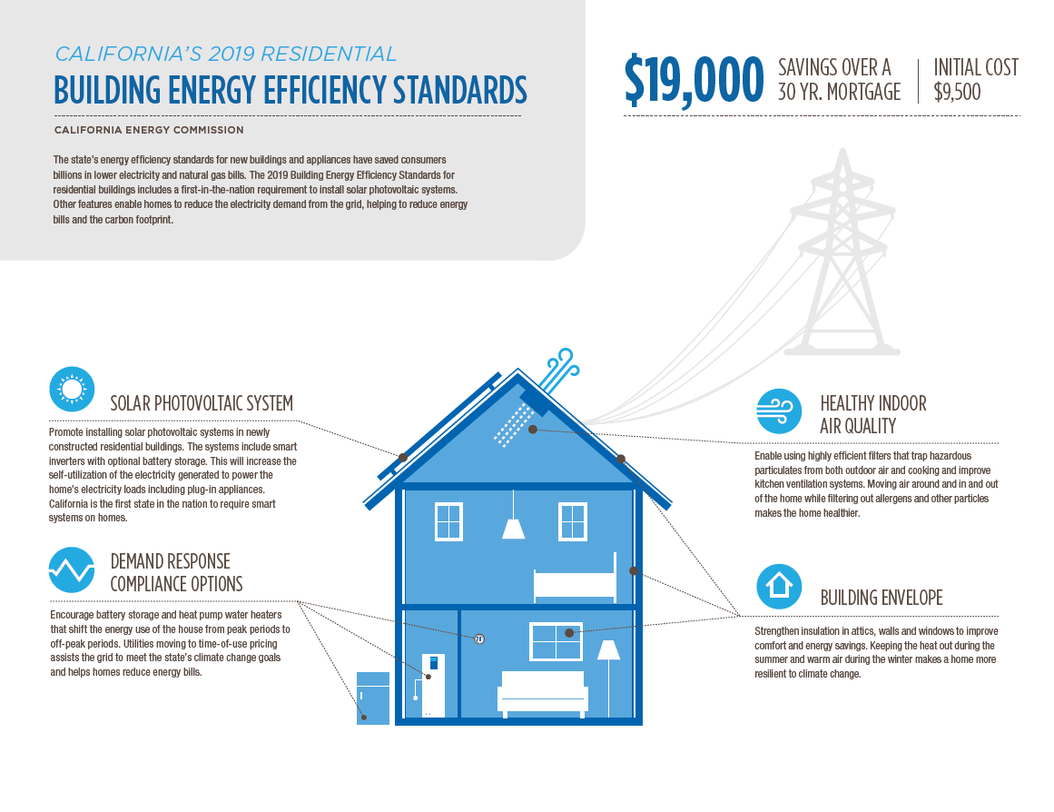
Energy Commission Infographic

Slide 27
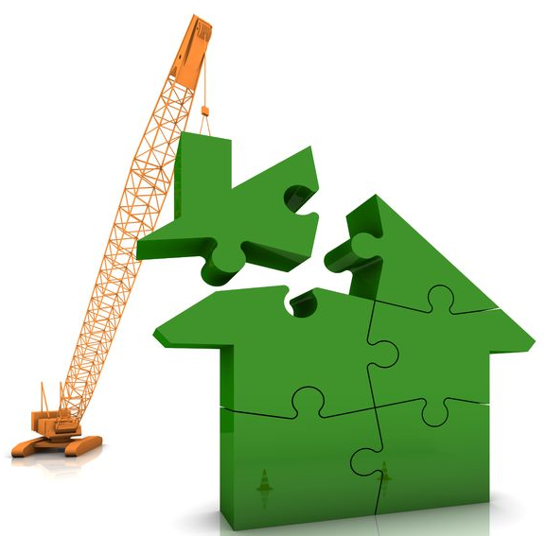
Energy Design Rating (EDR) (New)
150.1
ENERGY DESIGN RATING (EDR) for New Construction projects using performance method (TDV):
  100 represents the energy consumption of the building built to the specifications of the 2006 International Energy Conservation Code (IECC) home
  0 (zero) represents a building that has zero energy consumption
  Final EDR represents the overall TDV energy usage as a score
Building
Efficiency
-
PV +
Flexibility
=
Final
EDR Score
Your score
100
0

Slide 28
Compliance Metric (EDR) (New)
150.1
Building complies when:
  Building efficiency: Proposed ≤ Standard (baseline) and
  PV + flexibility: Proposed ≤ Standard (baseline)
Compliance Factors:
  PV + Battery may be used to reduce the PV size and building efficiency (min. requirements apply)
  EDR does not apply to additions and alterations (TDV budget applies)
PV and/or Flexibility (battery) + unregulated loads (lighting, appliances, plug loads)
Building Efficiency: Envelope + HERS (QII) + HVAC + DHW + unregulated loads (lighting, appliances, plug loads)
Building
Efficiency
Standard EDR
≥
Proposed EDR
PV +
Flexibility
Standard EDR
≥
Proposed EDR
Must comply
separately
to
achieve
compliance
and

Slide 29
Photovoltaic Systems (New)
150.1(c)14
Table 150.1-C – CFA and Dwelling Adjustment Factors
Climate Zone | A - CFA | B - Dwelling Units
1 | 0.793 | 1.27
2 | 0.621 | 1.22
3 | 0.628 | 1.12
4 | 0.586 | 1.21
5 | 0.585 | 1.06
6 | 0.594 | 1.23
7 | 0.572 | 1.15
8 | 0.586 | 1.37
9 | 0.631 | 1.36
10 | 0.627 | 1.41
11 | 0.836 | 1.44
12 | 0.613 | 1.40
13 | 0.894 | 1.51
14 | 0.741 | 1.26
15 | 1.56 | 1.47
16 | 0.59 | 1.22
A PV system is now required for all single family buildings
DC Rating = (CFA x A) / 1000 + (NDwell x B)
  CFA = Conditioned floor area
  NDwell = Number of dwelling units
  A = Adjustment factor from Table 150.1-C
  B = Dwelling adjustment factor from Table 150.1-C
Examples:
  Single Family: 2,000 ft² home in LA (CZ9)
    (2000 x 0.631)/1000 + (1x1.36) = 2.6 kW

Slide 30
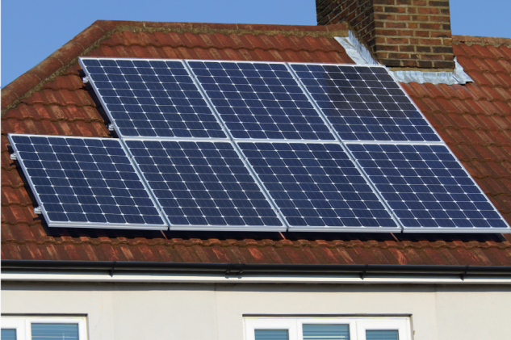
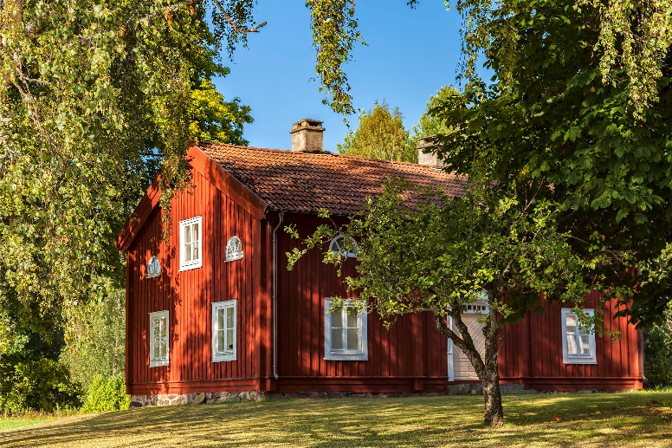
PV Exceptions
150.1(c)14
Effective annual solar access:
Solar Access = Solar Insolation Including Shading
Solar Insolation without Shading
Solar Access Verification.
  Installer to demonstrate shading condition compliance of installed PV via CF2R using either:
  Solar Assessment Tool approved by the Energy Commission and used per the manufacturer’s instructions OR
  An Aerial satellite, drone or digital image.
EXCEPTION 1 to Section 150.1(c)14: No PV is required if the effective annual solar access is restricted to less than 80 contiguous square feet external to the dwelling.
EXCEPTION 2 to Section 150.1(c)14: In climate zone 15, the PV size shall be the smaller of a size that can be accommodated by the effective annual solar access or a PV size required by the Equation 150.1-C, but no less than 1.5 Watt DC per square foot of conditioned floor area.
EXCEPTION 3 to Section 150.1(c)14: For dwelling units with two habitable stories, the PV size shall be the smaller of a size that can be accommodated by the effective annual solar access or a PV size required by the Equation 150.1-C, but no less than 1.0 Watt DC per square foot of conditioned floor area
EXCEPTION 4 to Section 150.1(c)14: For low-rise multifamily units with three habitable stories and single family dwellings with three or more habitable stories, the PV size shall be the smaller of a size that can be accommodated by the effective annual solar access or a PV size required by the Equation 150.1-C, but no less than 0.8 Watt DC per square foot of conditioned floor area.
EXCEPTION 5 to Section 150.1(c)14: For a dwelling unit plan that is approved by the planning department prior to January 1, 2020 with available solar ready zone between 80 and 200 square feet, the PV size is limited to the lesser of the size that can be accommodated by the effective annual solar access or a size that is required by Equation 150.1-C.
EXCEPTION 6 to Section 150.1(c)14: PV sizes from Equation 150.1-C may be reduced by 25 percent if installed in conjunction with an battery storage system. The battery storage system shall meet the qualification requirements specified in Joint Appendix JA12 and have a minimum capacity of 7.5 kWh.
For single-family homes, the solar zone must be located on its roof or overhang.

Slide 31
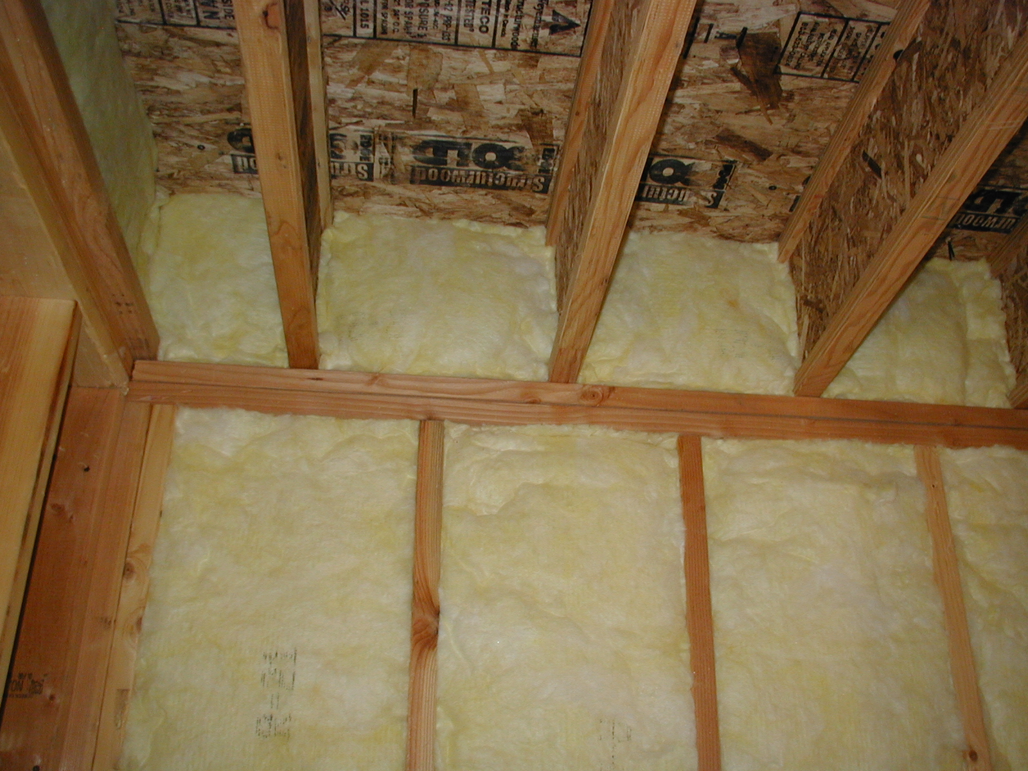
Quality Insulation Installation
150.1(c)1E
Quality Insulation Installation (QII) is now required on all single family buildings under Prescriptive compliance.
  Will set the baseline in performance approach.
Photo courtesy of Rick Chitwood

Slide 32



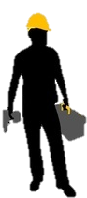
HERS Raters Involvement with QII
Forms reviewed by Building Inspector
Building Permit
Site/Foundation
Rough Install
Insulation
Installation
Finishes
Final Occupancy Permit
Preliminary meeting with HERS rater, review design
ALL insulation visually verified by HERS rater before covering
Air sealing visually verified by HERS rater BEFORE insulation

Slide 33

Additions
150.2(c)5
Extended/newly conditioned walls:
  2x4 requires R-15 insulation
  2x6 requires R-21 insulation (was R-19)
QII is required on additions >700 ft² (new)
  With limited exceptions for newly conditioned spaces (new)
Attic insulation in additions ≤700 ft²
  Zones 1, 11-16 require R-38 (was R-22)
  Zones 2-10 require R-30 (was R-22)
  Rafter roofs can be R-22

Slide 34
2019 Energy Code
Presenter:
Bruce Cheney
Code Development
All Occupancies
Nonresidential Measures
  Residential Measures
      Overview
    Building Feature Specific
Multifamily Measures
Wrap Up
Title 24 Part 6 Energy Efficiency Standards
Low-Rise Residential (including single family and low-rise multifamily) Occupancies
SUBCHAPTER 7 | Section 150.0 | MANDATORY FEATURES AND DEVICES
SUBCHAPTER 8 | Section 150.1 | PERFORMANCE AND PRESCRIPTIVE COMPLIANCE APPROACHES
SUBCHAPTER 9 | Section 150.2 | ADDITIONS AND ALTERATIONS TO EXISTING LOW-RISE RESIDENTIAL BUILDINGS

Slide 35
Low-Rise Residential Envelope

Slide 36
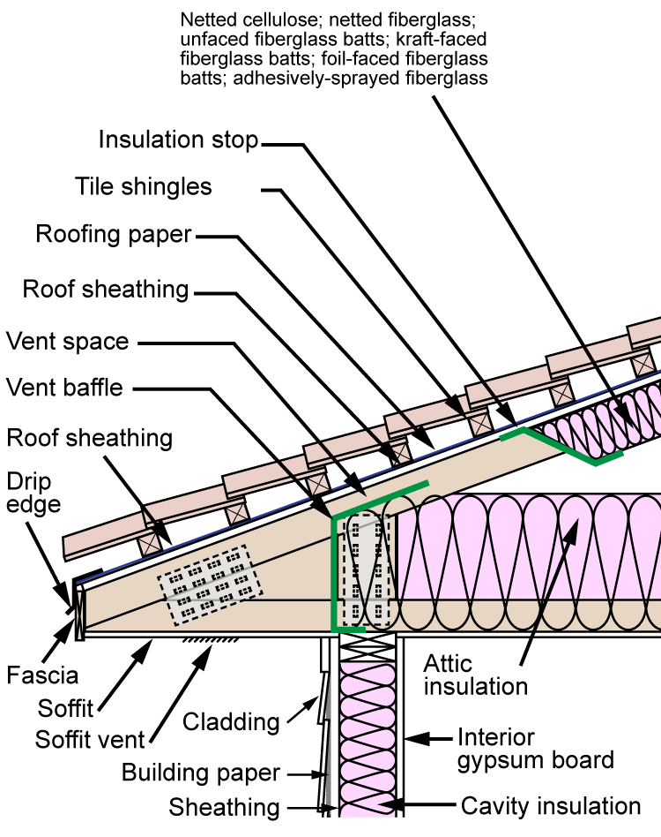
Below Deck Roof Insulation
150.1(c)1
Option B (Option A removed)
Below the roof deck insulation: R-19 (was R-13)
  Not required: CZ1-3, 5-7
Ceiling Insulation in vented attic:
  CZ 3, 5-7: R-30
  All Others: R-38
Airspace required (new)
Radiant barrier in CZ with no below roof desk insulation (CZ1-3, 5-7)
Option C (ducts in conditioned space) still an option

Slide 37
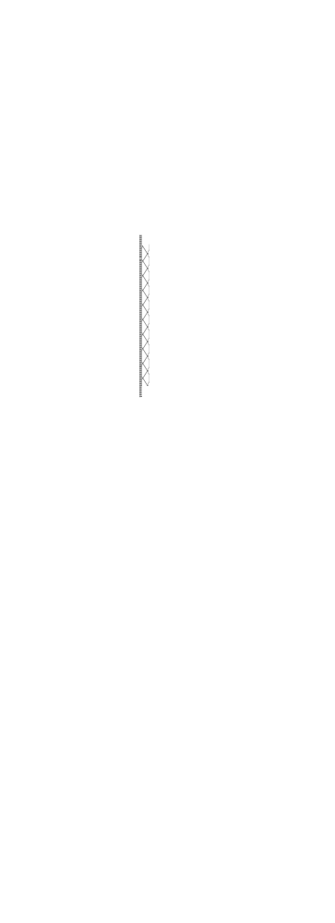

Framed Wall
150.0(c)
150.1(c)1Bi
Mandatory Minimum
2 x 4 = U-factor of 0.102 (R-13) /
2 x 6 U-factor of 0.071 (R-20) (was R-19)
Prescriptive: CZ 6-7
U-factor: 0.065 (2 x 4 with R-15 + R-4)
No change
Prescriptive: All Other CZ’s
U-factor: 0.048 (was 0.051)
  2 x 6 with R-21(was R-19) + R-5 (1”) or
  2 x 6 with R-19 + R-7 (1-1/2”) (was 1”) or
  2 x 4 with R-15 (was R-13) + R-10 (2”) or
  Whatever can meet the 0.048 U-factor

Slide 38
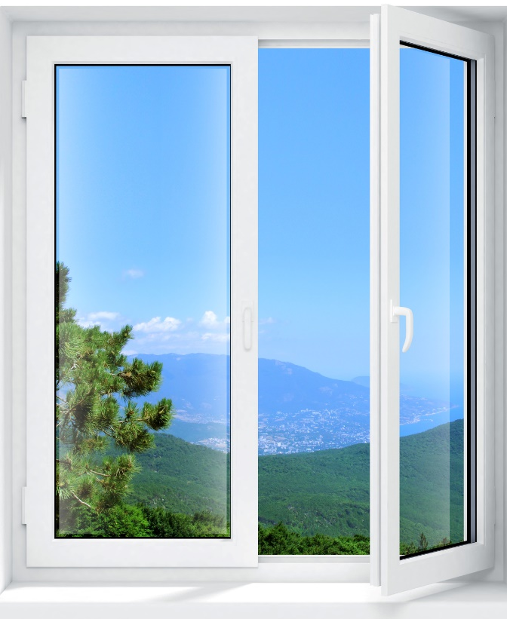
Fenestration & Doors
150.1(c)3A
Maximum U-Factor = 0.30 (was 0.32)
Maximum SHGC = 0.23 (was 0.25)
  No requirement in Zones 1,3,5 &16 (CZ 16 is a new exception)
    Zone 16 is now treated like the other heating climate zones, not like the cooling climate zones (encourages passive design)

Slide 39
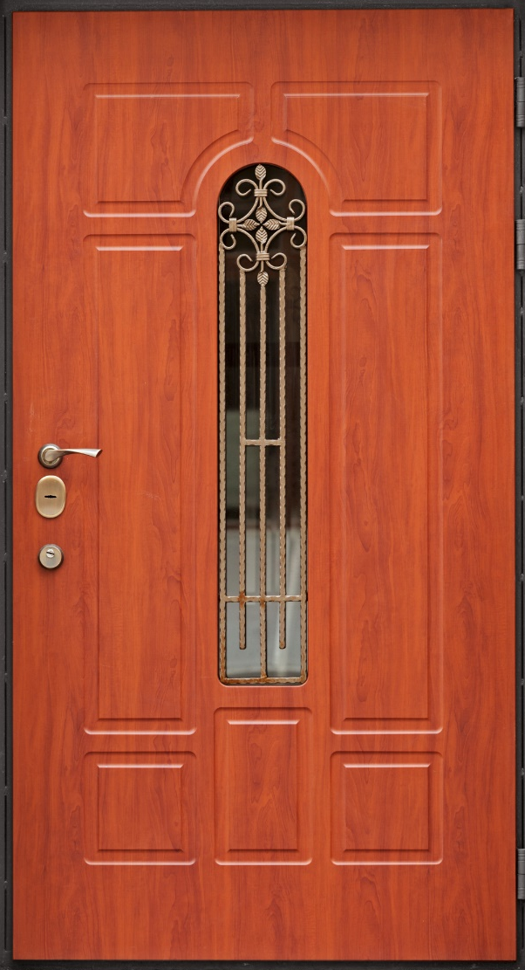
Opaque Doors
150.1(c)5
Subject to a maximum NFRC rated U-Factor requirement of 0.20 (new)
  Basically an R-5 insulated door.
Same in all Climate Zones
Includes doors to outside
and to unconditioned spaces
  Does not apply to doors from
  house to garage.
Doors with 25% or more glass now treated as fenestration (windows). (was 50%)

Slide 40
Low-Rise Residential Mechanical

Slide 41
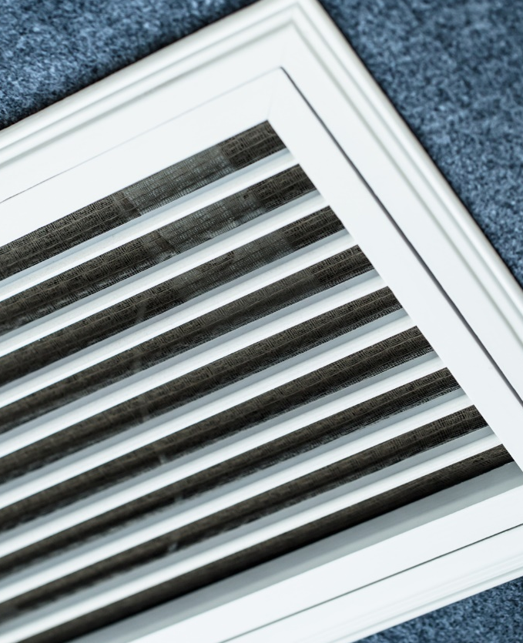
Ducts & Filters (New)
150.2(b)1D-E
150.0(m)1B
HERS duct testing (6% or smoke test) to be performed for new and altered systems (regardless of new duct length) when any of the following are located in garage:
  Altered/new ducts
  Air-handling unit
  Cooling or heating coils
  Plenums
Minimum 2” Filter (larger face area formula will allow for 1”)
Minimum MERV 13 filtration
  Filter not required if 10 feet or less of ductwork
Applies to new construction and alterations

Slide 42
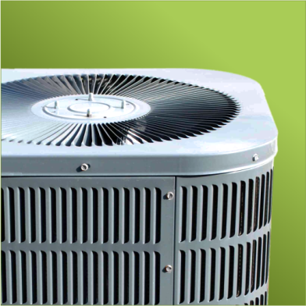
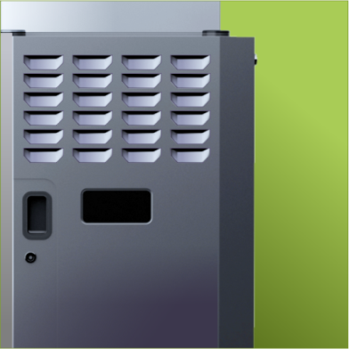
Fan Performance
150.0(m)13B
Gas Furnace & AC:
  Fan wattage must be HERS tested on forced air system with cooling to be no more than 0.45 W/cfm. (was 0.58 w/cfm)
    This is possible when using furnaces dictated by Federal guidelines that goes into play July 2019 setting max. efficacy limits for residential furnace fans, otherwise known as a Fan Efficacy Rating (FER).
    EXCEPTION: Gas furnaces allowed to meet 0.58 w/cfm if manufactured before July 3, 2019.
  Other air handlers such as heat pumps and fan coils can still be 0.58 W/cfm
A picture of a gas furnace
iStock: 187569310

Slide 43
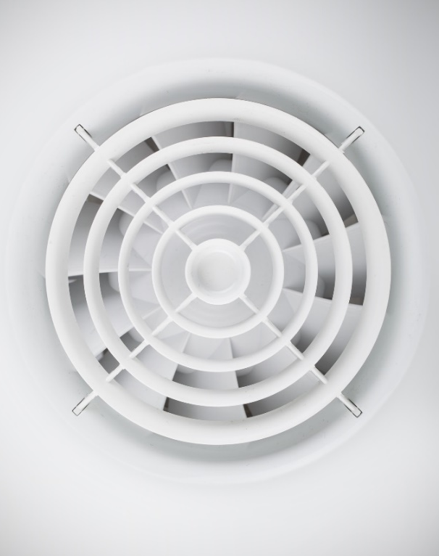
Single Family IAQ Fans
150.0(o)
Total Required Ventilation Rate (Equation 150.0-B)
  Q_{tot} = 0.03 x A_{floor} + 7.5 x (N_{br} + 1) (Now only Total Ventilation Rate Method is allowed)
    Q_{tot}=total required ventilation rate, cfm
    A_{floor}=dwelling-unit floor area ft²
    N_{br}=number of bedrooms (not to be less than 1)
The ventilation rate associated with infiltration is calculated using an effective leakage area (ELA) value that must be HERS verified in the field: ELA using either (Equation 150.0-C)
    Q₅₀ = V_{du} x 2 ACH₅₀)/60 min OR
    If leakage >2 ACH₅₀ , be HERS verified per Equation 150.0-D
  The leakage is normalized based on the area of the house and the potential for stack effect with the effective annual infiltration rate (Equation 150.0-E)
    Q_{inf} = 0.052 × Q₅₀ (from Equation 150.0-C or D)× wsf × [H/H_{r}]^{z}
Required Mechanical Ventilation Rate = Total Required Ventilation Rate - effective annual infiltration rate (Equation 150.0-F)
  Q_{fan} = Q_{tot} (from Equation 150.0-B) – Φ (Q_{inf} (from Equation 150.0-E)× A_{ext})
Aligning with ASHRAE 62.2
Applies to additions >1,000 ft² AND when a new dwelling unit is added to an existing residential building (i.e. ADU) (new)

Slide 44
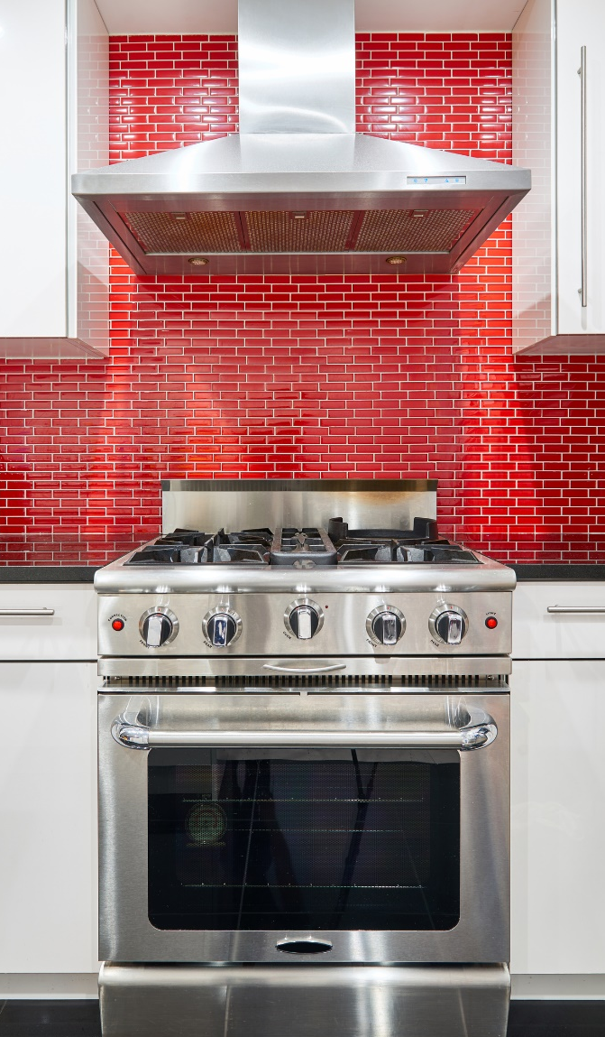
Range Hoods (New)
150.0(o)2B
Range hoods must be HERS inspected in the field to verify:
  Maximum sound ratings per ASHRAE 62.2 (3.0 sones)
Kitchen Hood requirements of Table 5.1/5.2 of 2016 ASHRAE 62.2
Ventilation Control Type | Application | Airflow
Demand-Controlled Local Ventilation Exhaust Airflow Rates | Enclosed Kitchen: permanent openings to interior adjacent spaces do not exceed a total of 60 ft² | Vented range hood (including appliance-range hood combinations): 100 cfm (50 L/s) Other kitchen exhaust fans, including downdraft: 300 cfm (150 L/s) or a capacity of 5 ach
 | Non-enclosed Kitchen | Vented range hood (including appliance-range hood combinations): 100 cfm (50 L/s) Other kitchen exhaust fans, including downdraft: 300 cfm (150 L/s)
Continuous Local Ventilation Exhaust Airflow Rates | Enclosed Kitchen | 5 air changes per hour, based on kitchen volume
Aligning with ASHRAE 62.2

Slide 45
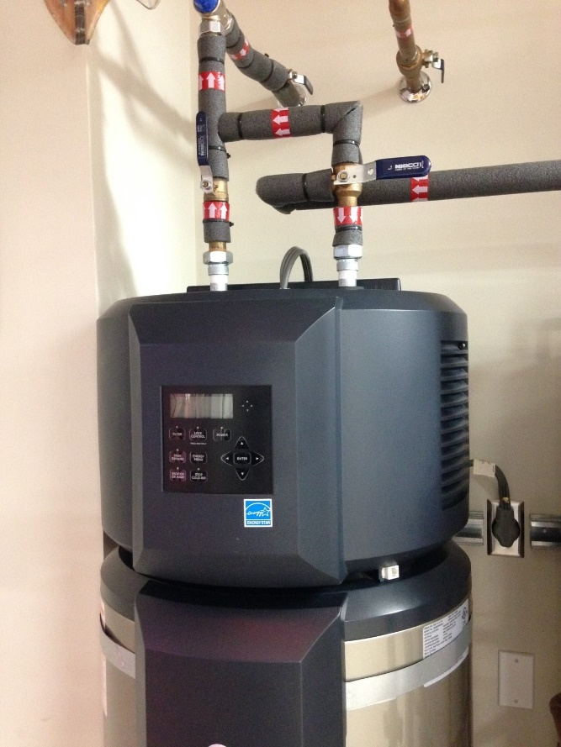
Domestic Hot Water (DHW) New
150.1(c)8A
Applicable to one DHW per dwelling unit including single family and multifamily)
  One heat pump water heater IN GARAGE or CONDITIONED SPACE AND
    HERS verified Compact hot water distribution and a drain water heat recovery system OR
    Add additional PV capacity:
      CZ 2-15: increase PV size by 0.3 kW
      CZ 1&16 increase PV size by 1.1 kW OR
  One Tier III NEEA rated (or higher) heat pump water heater with storage tank in garage or conditioned space
    If located in CZ 1&16: must increase the PV size by 0.3 kW

Slide 46
2019 Energy Code
Presenter:
Marina Blanco
Code Development
All Occupancies
Residential Measures
  Multifamily Measures
    Low-rise and Highrise
Nonresidential Measures
Wrap Up

Slide 47
Low-Rise Multifamily:
What’s Different from Single Family

Slide 48
Low-Rise Multifamily:
Framed Wall
150.0(c)
150.1(c)1Bi
Mandatory Min.
2 x 4 = U-factor of 0.102 (R-13) /
2 x 6 U-factor of 0.071 (R-20) (was R-19)
Prescriptive: CZ 6-7(no change)
U-factor: 0.065
2 x 4 with R-15 + R-4 (1”) example
Prescriptive: All Other CZ’s
U-factor: 0.051 (no change; single family changed to 0.048)
2 x 6 with R-19 + R-5 (1”) example

Slide 49
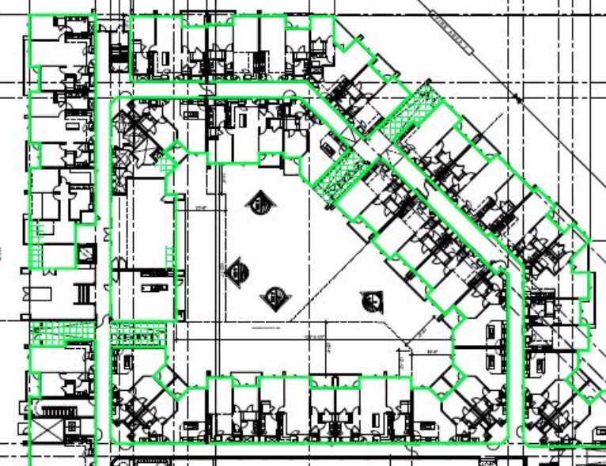
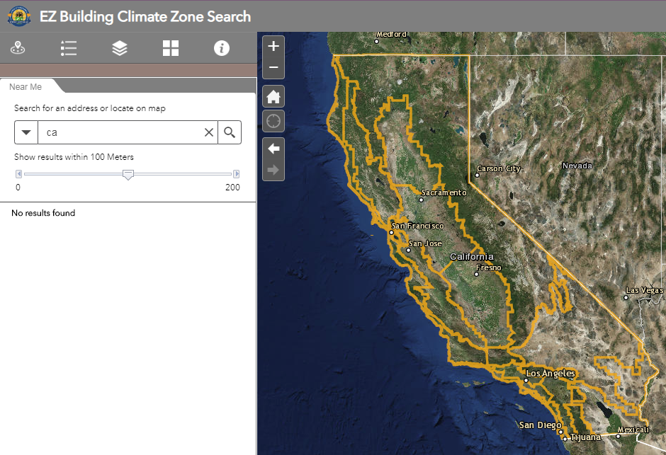
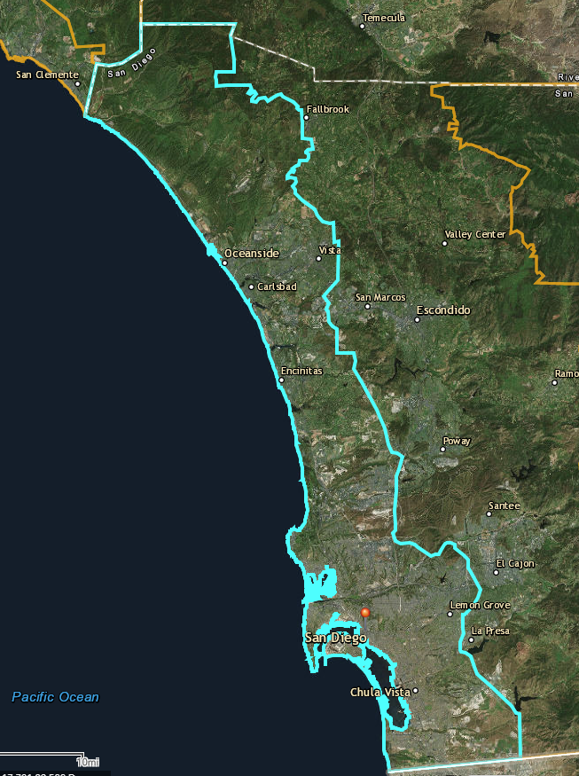
Quality Insulation Installation New
150.1(c)1E
Quality Insulation Installation (QII) is now required on most low-rise multifamily buildings under
Prescriptive compliance.
  Climate Zone 7 not required
Air barrier verification is more challenging than single family.
Photo courtesy of Bright Green Strategies

Slide 50
Photovoltaic Systems (New)
150.1(c)14
Table 150.1-C – CFA and Dwelling Adjustment Factors
Climate Zone | A - CFA | B - Dwelling Units
1 | 0.793 | 1.27
2 | 0.621 | 1.22
3 | 0.628 | 1.12
4 | 0.586 | 1.21
5 | 0.585 | 1.06
6 | 0.594 | 1.23
7 | 0.572 | 1.15
8 | 0.586 | 1.37
9 | 0.631 | 1.36
10 | 0.627 | 1.41
11 | 0.836 | 1.44
12 | 0.613 | 1.40
13 | 0.894 | 1.51
14 | 0.741 | 1.26
15 | 1.56 | 1.47
16 | 0.59 | 1.22
A PV system is now required for and low-rise multifamily buildings
DC Rating = (CFA x A) / 1000 + (NDwell x B)
  CFA = Conditioned floor area
  NDwell = Number of dwelling units
  A = Adjustment factor from Table 150.1-C
  B = Dwelling adjustment factor from Table 150.1-C
Examples:
  Low-rise Multifamily: 21,000 ft² 30-unit 2 story apartment building in Oakland (CZ3)
    (21000 x 0.628)/1000 + (30x1.12) = 47 kW

Slide 51

High-Rise Multifamily
110.10(b)
New Exceptions to Solar Ready
Demand response thermostat (certified OpenADR 2.0a/b) in EVERY dwelling unit AND
  Meet Title 24 Part 11 A4.106.8.2 for EV charging spaces (Requires raceway, panel capacity, and area for charging station(s)) AND one of the following:
    Energy Star dishwasher, refrigerator AND a whole house fan (using electronically commutated motor) OR
    Demand response home automation system (per Section 110.12(a)) controlling appliances and lighting OR
    CA Plumbing Code greywater system to be used for irrigation system OR
    CA Plumbing Code rainwater catchment system using 65% of roof rainwater.

Slide 52
Low-Rise & High-Rise Multifamily
Mechanical

Slide 53
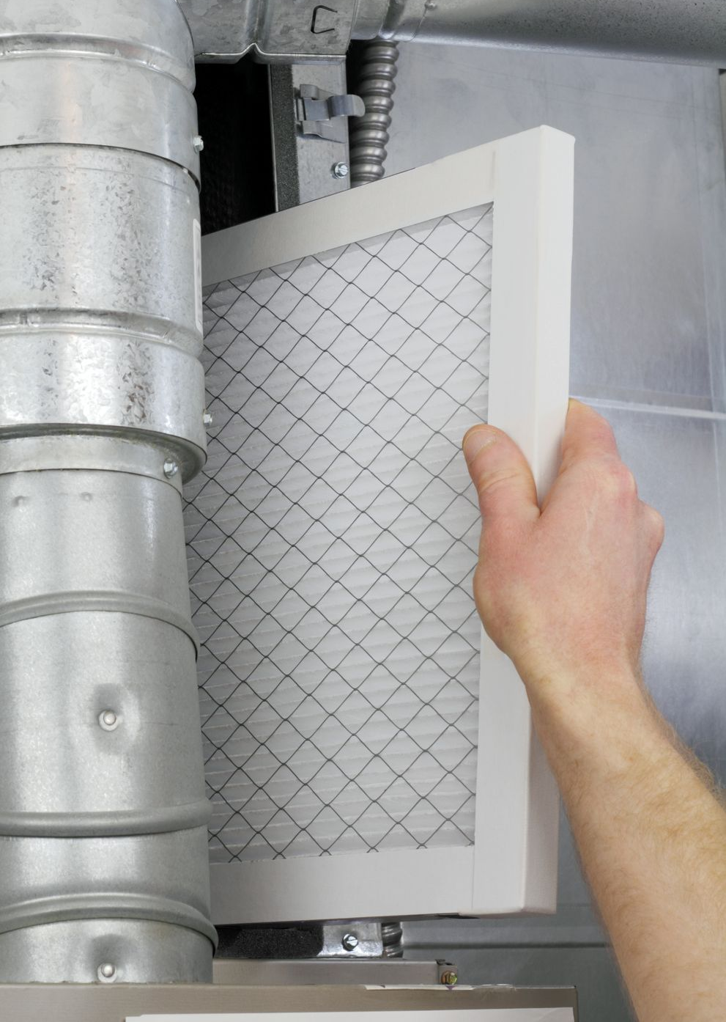
Air Filtration New
120.1(b)
Applicable to low-rise AND high-rise occupancies
  Establishes minimum air filter requirements:
    Applicable to ducted systems
    Systems that provide outside air or recirculate air
  Minimum 2” Filter (larger face area formula will allow for 1”)
  Minimum MERV 13 filtration

Slide 54
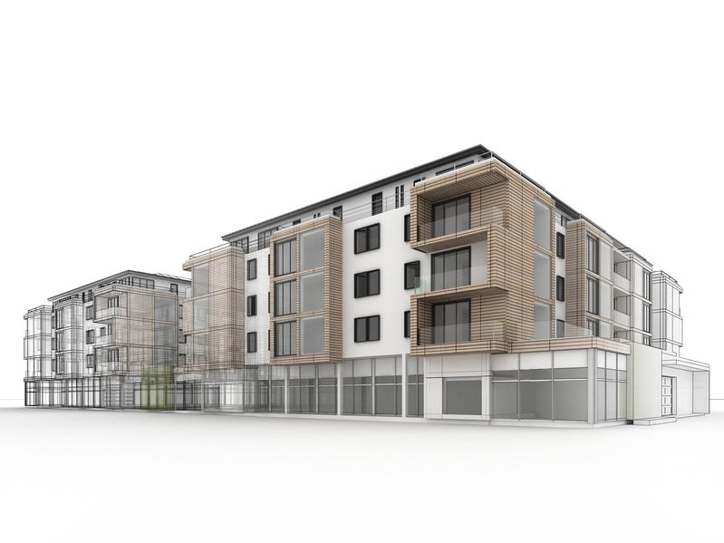
Multi-Family IAQ New
120.1(b)
150.0(o)1E-F
There are 2 new methods to how IAQ can be provided for multifamily (both Low-Rise and High-Rise) using individual systems for each unit:
  Balanced ventilation system
  OR
  Continuous supply or exhaust ventilation system WITH HERS/ATT verified envelope leakage
    0.30 cubic ft per minute at 50 Pa (0.2” water) per ft² or less
Operable windows not permitted as a source of ventilation
Continuous operation of the forced air system not a permitted as a source of ventilation
Aligning with ASHRAE 62.2
Central ventilation systems to be balanced oversized no more than 20% using system balancing such as:
  constant air regulation devices
  orifice plates
  variable speed central fans

Slide 55
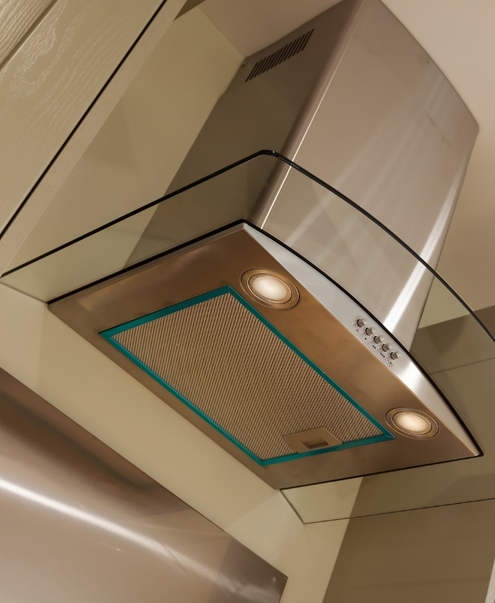
Range Hoods New
150.0(o)2B
120.1(b)
Range hoods must be HERS (low-rise) or ATT (high-rise) inspected in the field to verify:
  Maximum sound ratings per ASHRAE 62.2 (3.0 sones)
Kitchen Hood requirements of Table 5.1/5.2 of 2016 ASHRAE 62.2
Ventilation Control Type | Application | Airflow
Demand-Controlled Local Ventilation Exhaust Airflow Rates | Enclosed Kitchen: permanent openings to interior adjacent spaces do not exceed a total of 60 ft² | Vented range hood (including appliance-range hood combinations): 100 cfm (50 L/s) Other kitchen exhaust fans, including downdraft: 300 cfm (150 L/s) or a capacity of 5 ach
 | Non-enclosed Kitchen | Vented range hood (including appliance-range hood combinations): 100 cfm (50 L/s) Other kitchen exhaust fans, including downdraft: 300 cfm (150 L/s)
Continuous Local Ventilation Exhaust Airflow Rates | Enclosed Kitchen | 5 air changes per hour, based on kitchen volume
Aligning with ASHRAE 62.2

Slide 56
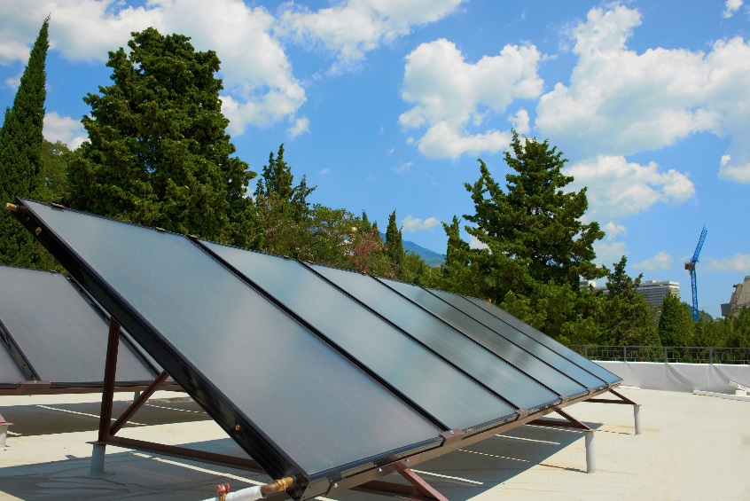
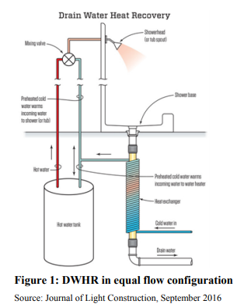
Drain Water Heat Recovery New
150.1(c)8B
Solar savings fraction (SSF) can be reduced by 5% if HERS verified drain water heat recovery system used:
  CZ 1-9: 20% SSF
    Reduced to 15% SSF
  CZ 10-16: 35% SSF
    Reduced to 30% SSF
Min. rated effectiveness = ≥42%
Recover heat from 50% of the showers located above the first floor and:
  Must at least transfer that heat either back to all the respective showers, or the water heater.

Slide 57
And Now It’s Time For Some Sli.do Fun!

Slide 58
Check Your Understanding
2
Are YOU ready for 2019 Energy Code?
Yes, bring it on!
No, I need time to absorb
SOS

Slide 59
2019 Energy Code
Presenter:
Martyn Dodd
Code Development
All Occupancies
Nonresidential Measures
Residential Measures
Multifamily Measures
  Wrap Up

Slide 60
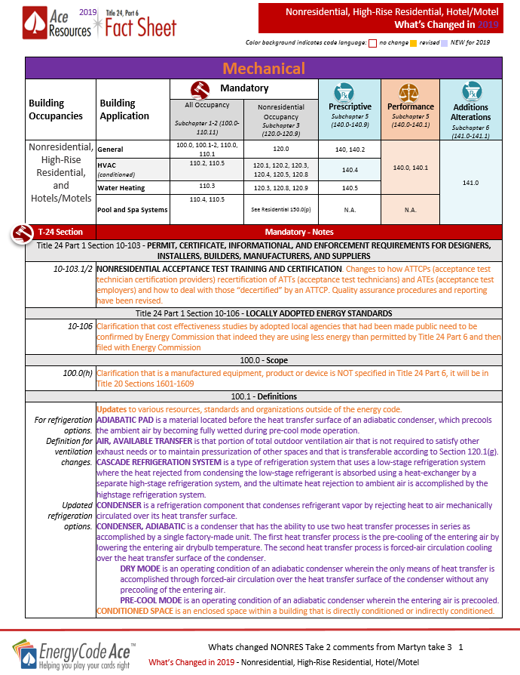
Coming Soon!
2019 “What’s Changing For Title 24 Part 6” Factsheet
Residential
Nonresidential
Multifamily
Healthcare

Slide 61
Afternoon Sessions
Join Us for Our Afternoon Sessions!
Residential
Nonresidential
First Round
  Residential New Construction: Single Family Homes
  Low-Rise and High-Rise Multifamily: New Construction
Second Round
  Residential Alterations and Additions: Single Family Homes
  Low-Rise and High-Rise Multifamily: Alterations and Additions
First Round
  Nonresidential Lighting and Electrical for New Construction
  Nonresidential HVAC for New Construction
Second Round
  Nonresidential Lighting and Electrical for Alterations
  Nonresidential HVAC for Alterations

Slide 62


Thank you!
Contact | Role | Email | Phone
Martyn Dodd | Instructor | Mart@energysoft.com | 415-897-6400
Gina Rodda | Instructor | gina@gabelenergy.com | 510-428-0803
Brian Selby | Instructor | brian@selbyenergyinc.com | 209-352-2281
Bruce Cheney | Instructor | Bruce@aae-hers.com | 858-254-1189
Marina Blanco | Instructor | marina@gabelenergy.com | 510-428-0803
Jill Marver Ruby Yepez Jeremy Reefe Ray Mendoza | PG&E SCE Sempra Sempra | jkz1@pge.com Ruby.R.Yepez@sce.com JMReefe@semprautilities.com RJMendo1@semprautilities.com | 925-415-6844 626-302-0699 858-636-5533 562-803-7493

